Slide 1
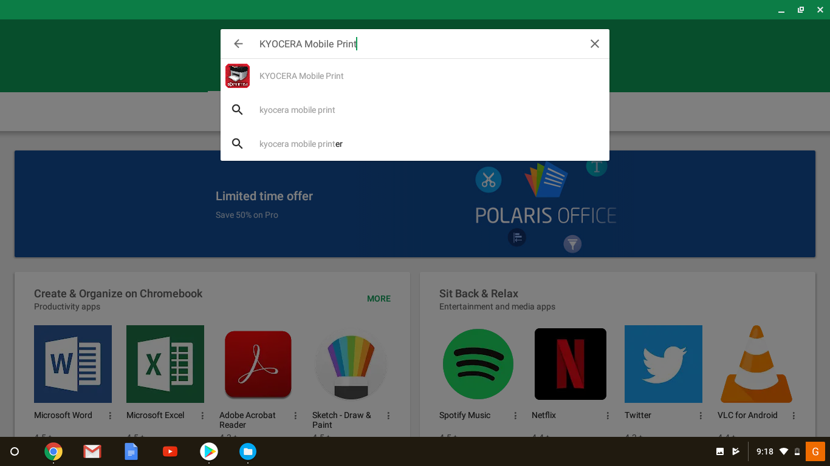
Open your Play Store, Look for: Kyocera Mobile Print

Slide 2
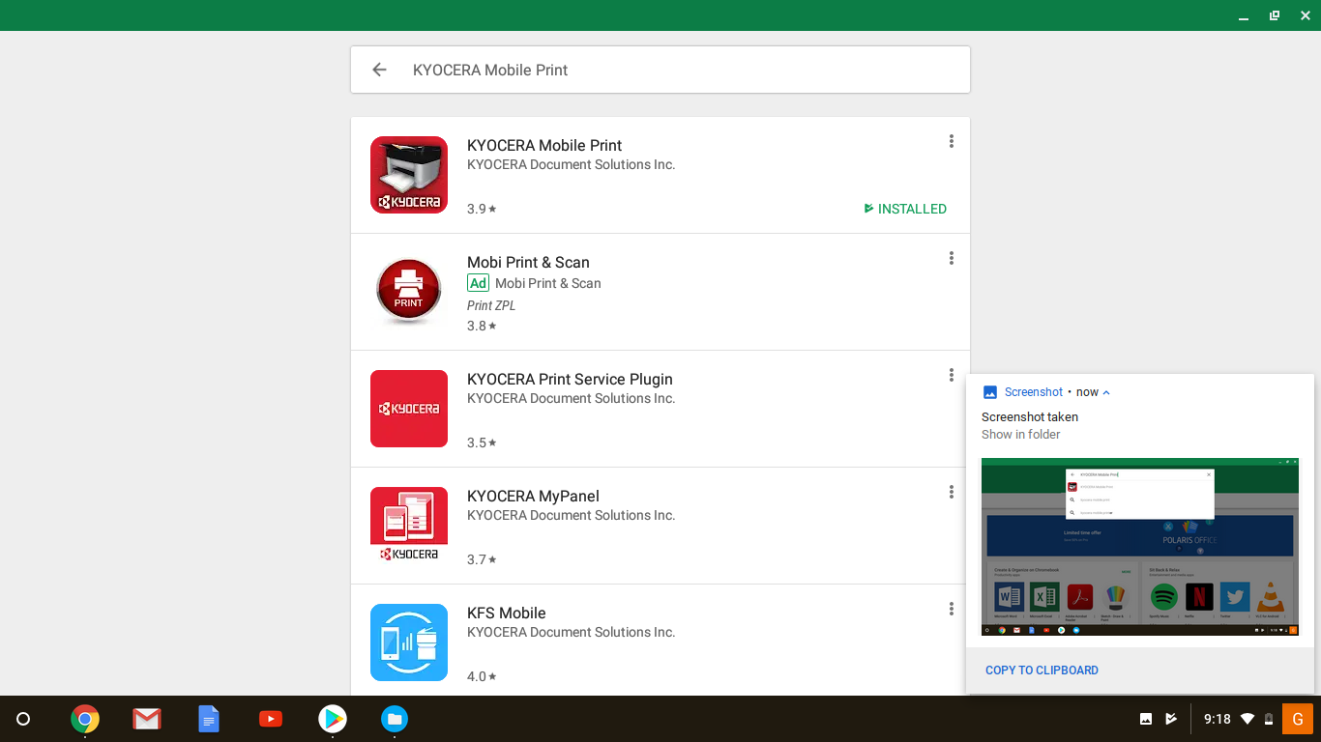
You will see the available app: Kyocera Mobile Print. Click on the app.

Slide 3
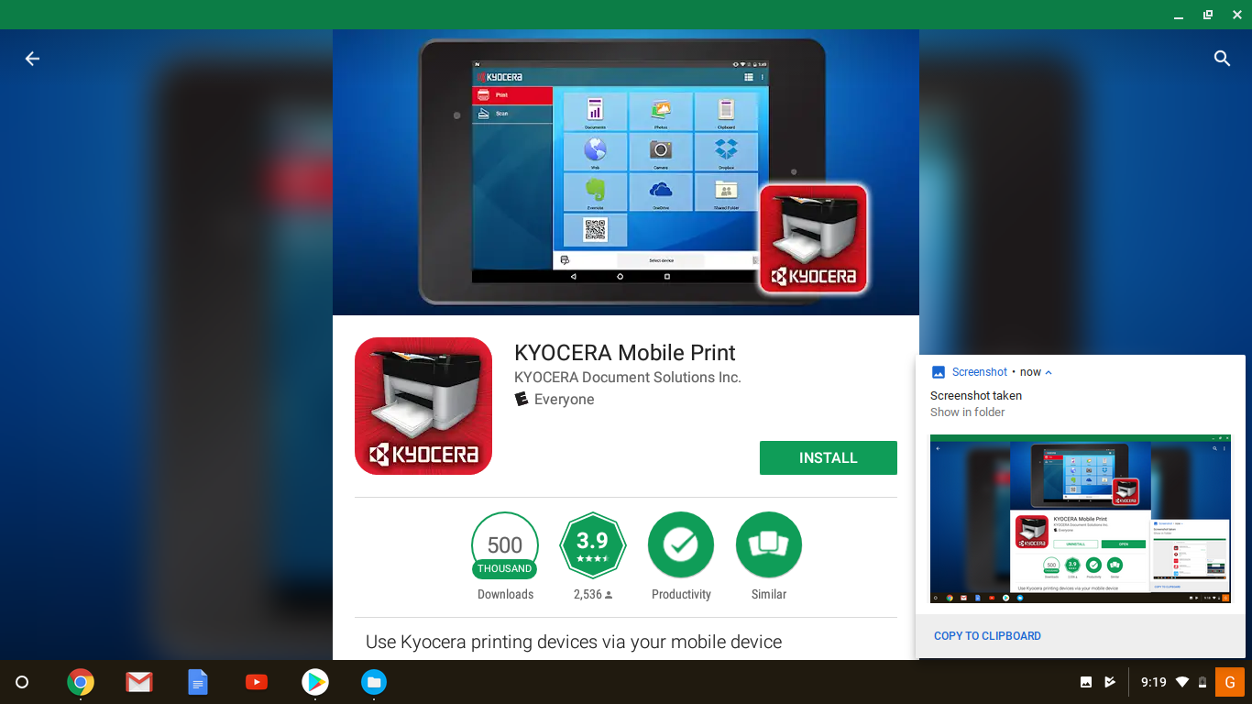
Once the app info apears on the screen, click on “Install” button.

Slide 4
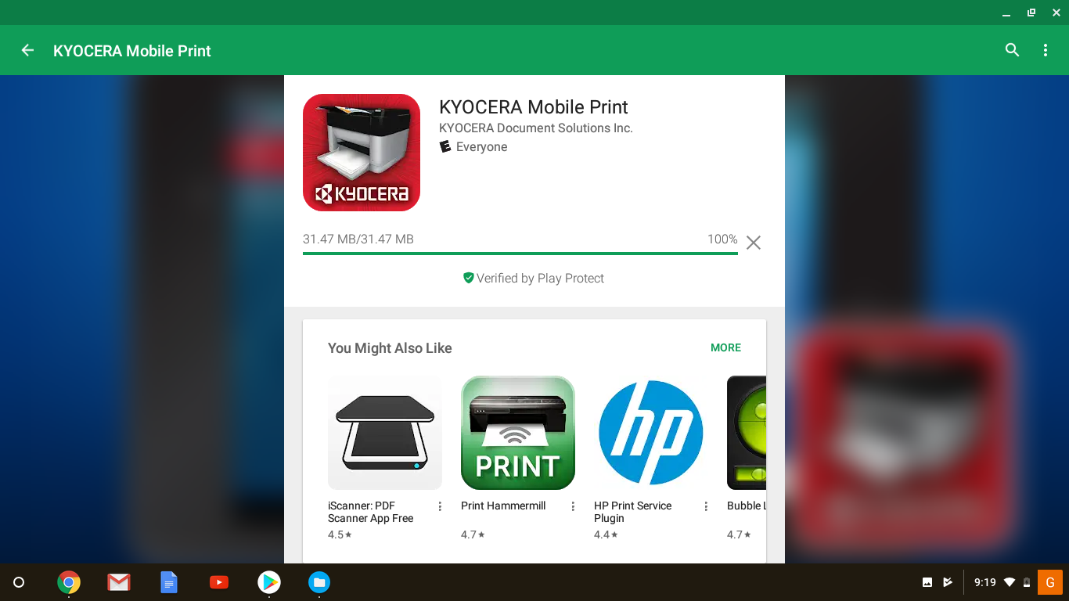
Installation process will start shortly, you will see the status bar.

Slide 5
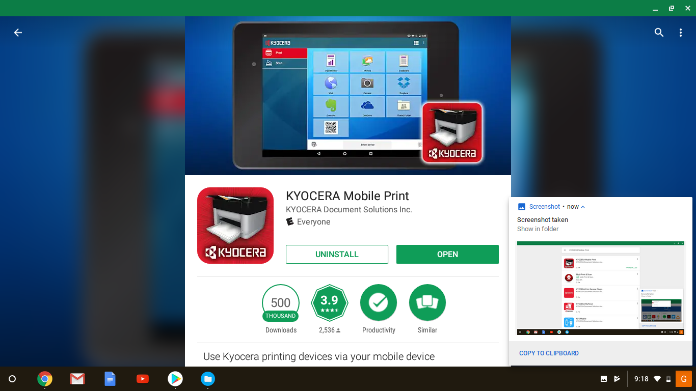
After the installation is over, the “open / uninstall” window appear. Click on “Open”.

Slide 6
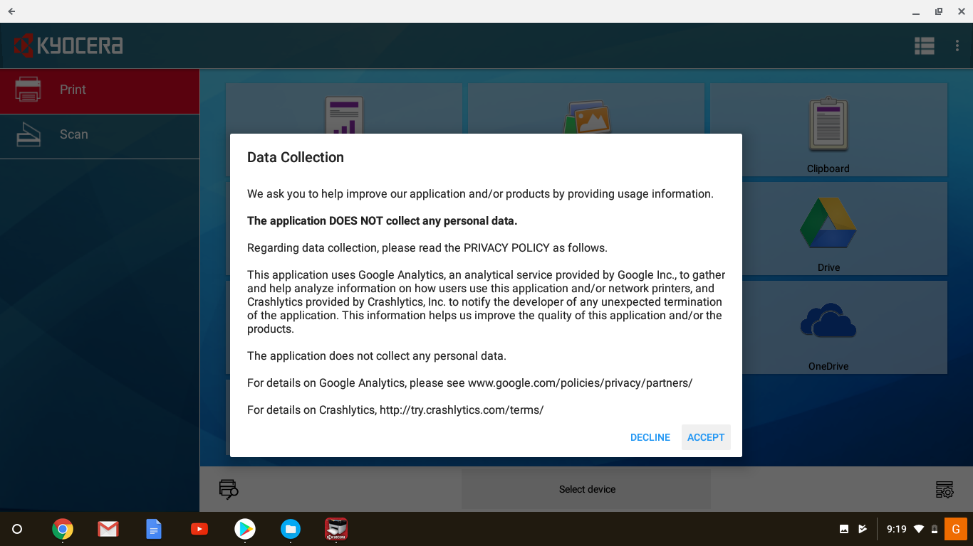
The application itself will be opened on your device. Click “Accept”.

Slide 7
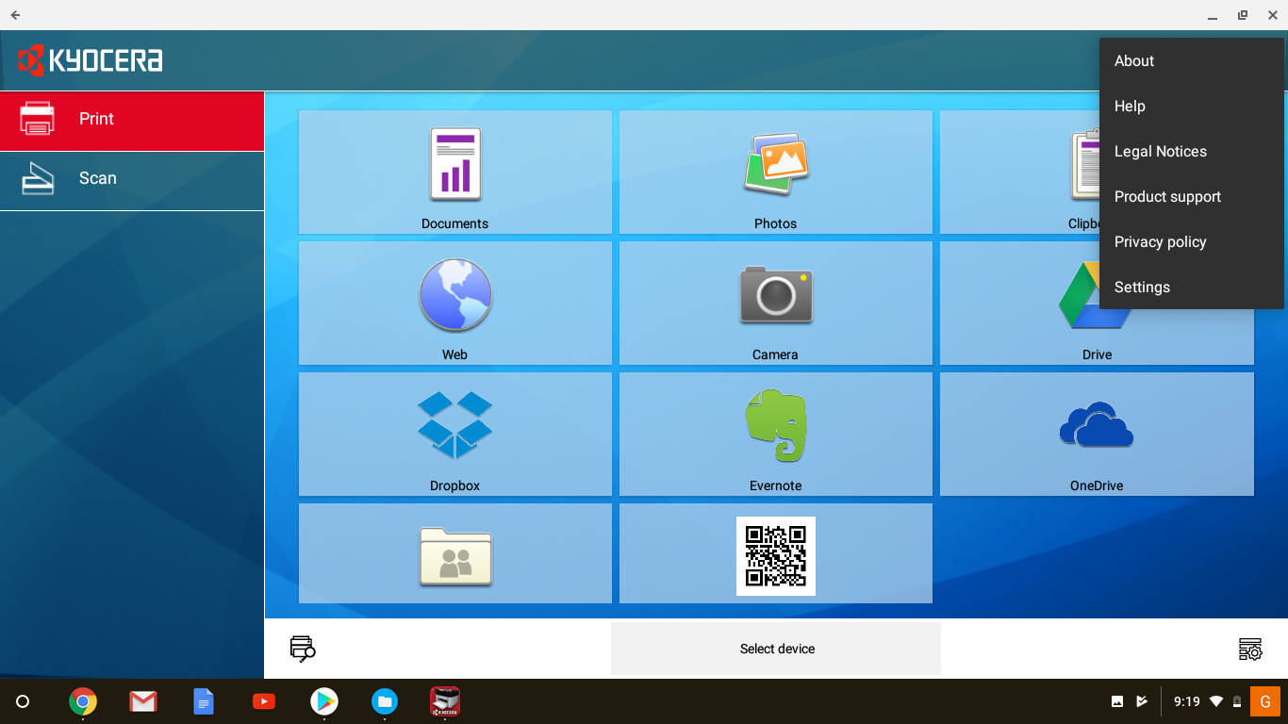
Click on three dots (settings) on the right top corner and choose “Settings”

Slide 8
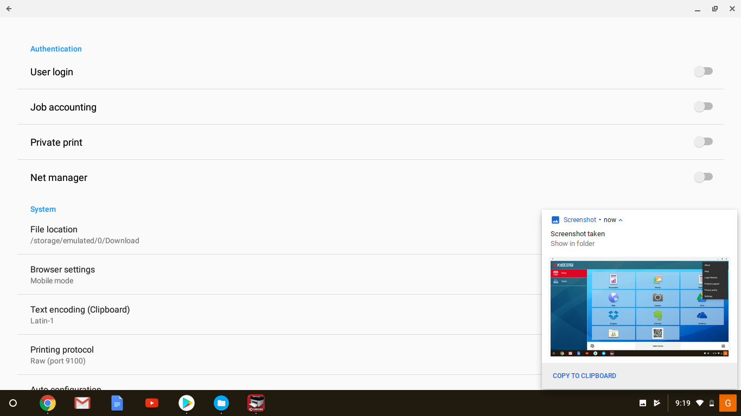
You will see this screen. Activate “Net Manager” (4th line from the top).

Slide 9
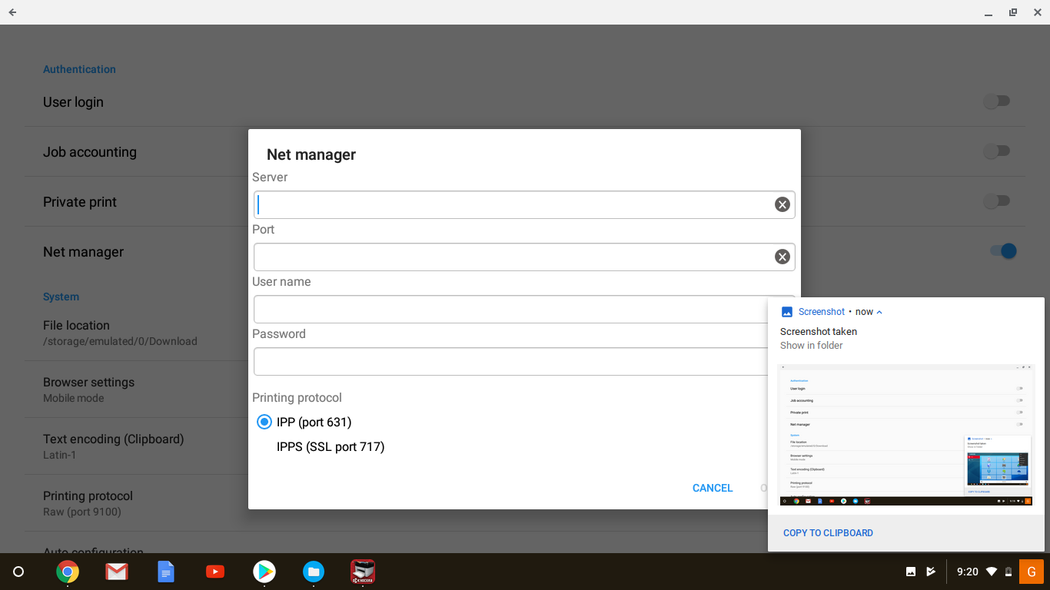
Obtain “Server” and “User name” from your Tech support. Notice: Port is 9094 for everyone! Password is 1087 for everyone!

Slide 10
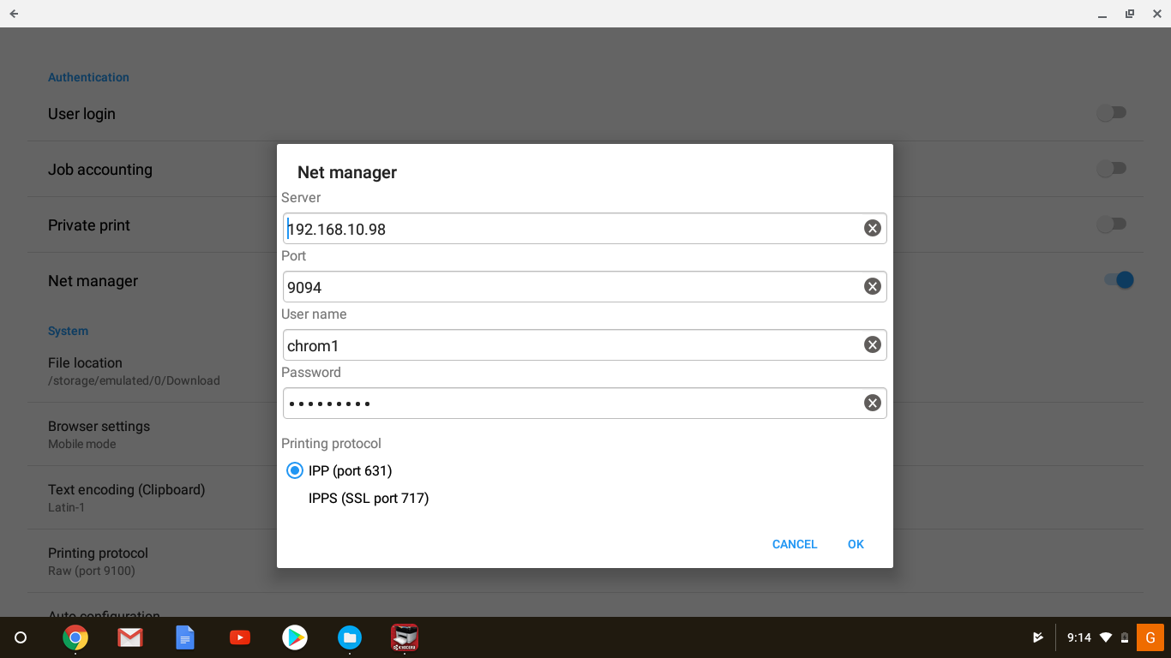
Your screen should look like this! With Server and User name diff from the sample. Click on OK button.

Slide 11
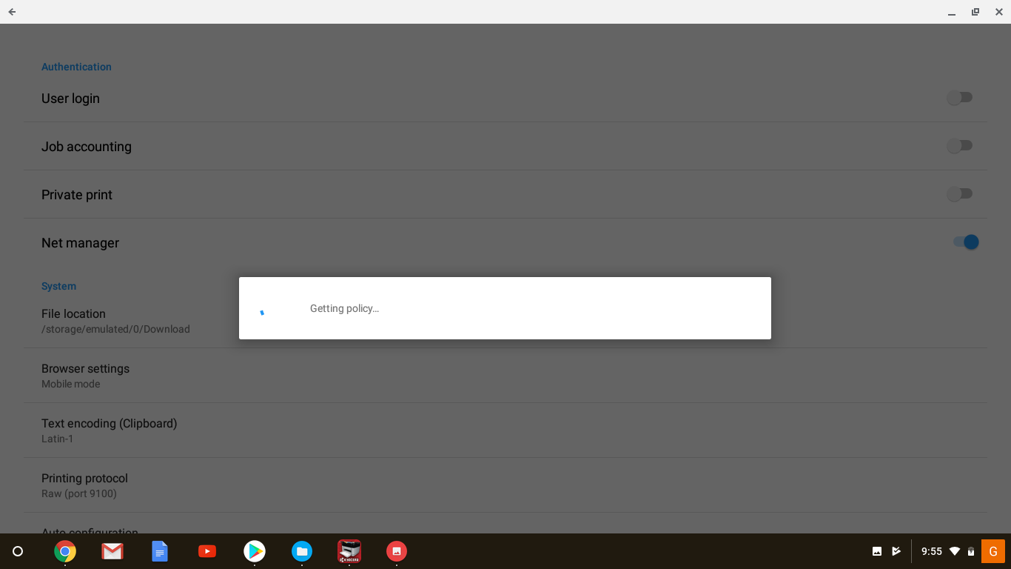
The application will obtain your account information from the server. So wait for it.

Slide 12
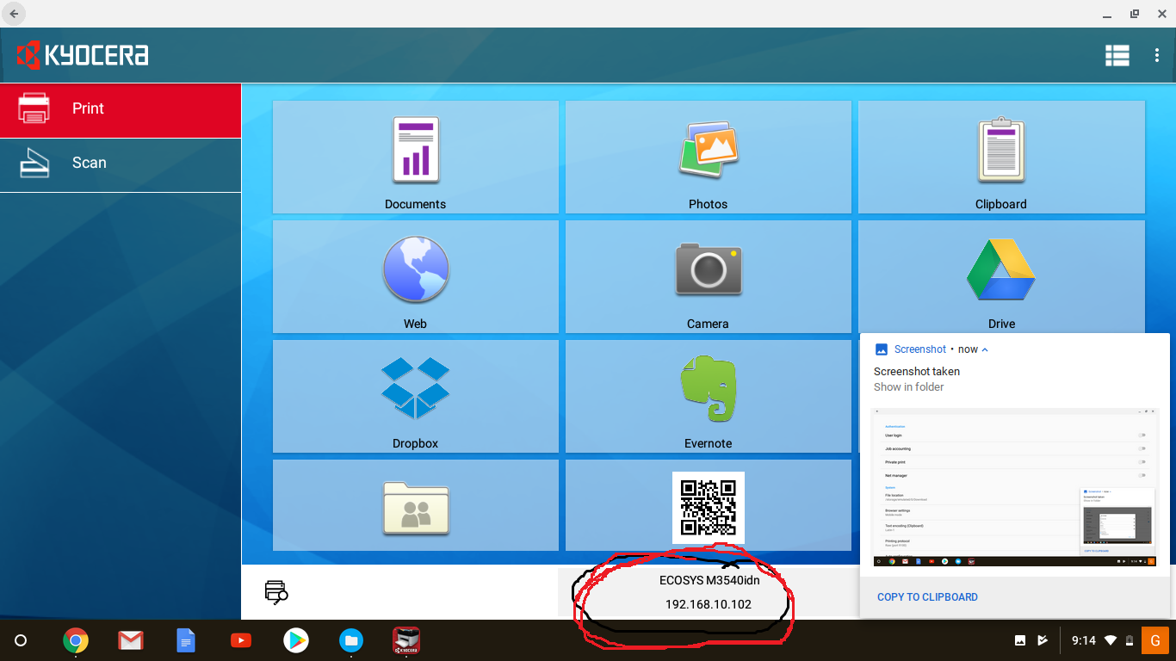
Once your app is configured and connected, you will see the main screen again. Click on “Queue” at the bottom of the page. In my case: ECOSYS M3540idn

Slide 13
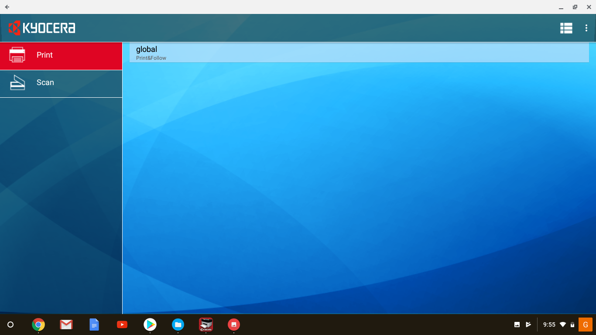
Choose the queue: Chromebooks In my case: global

Slide 14
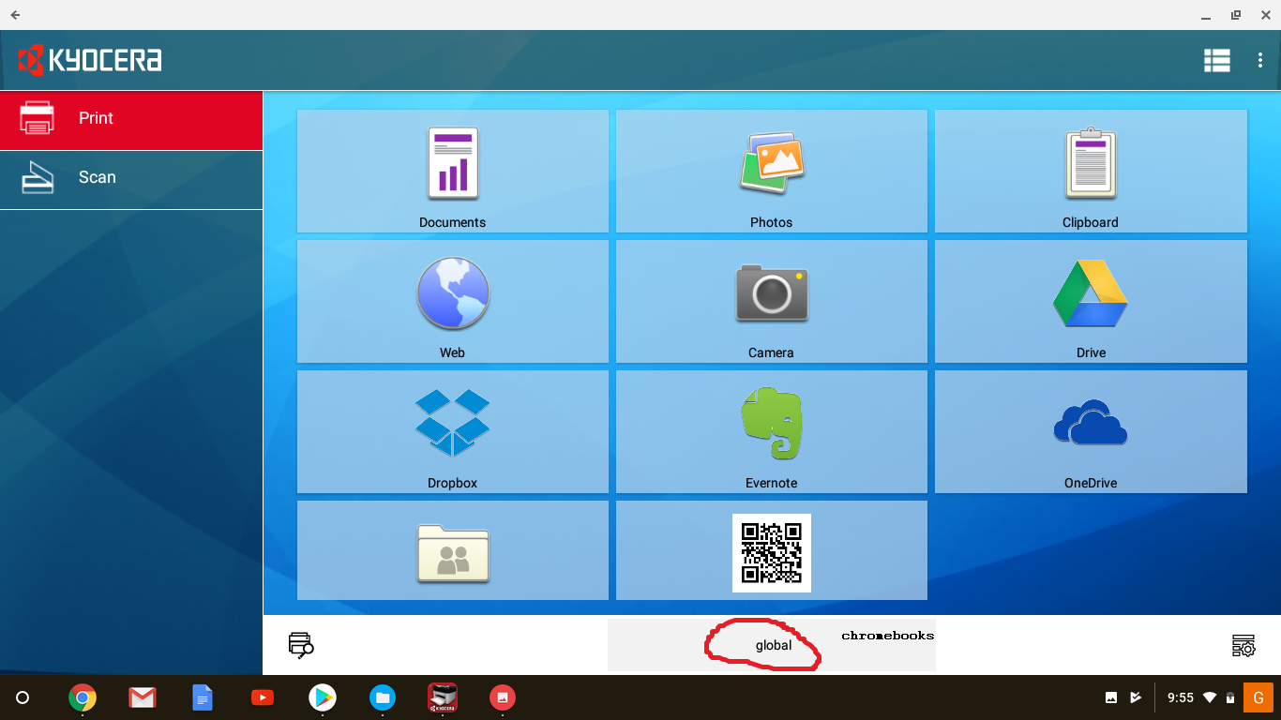
Your screen should look like this, but where it says “global” your app will say “chromebooks”. Click on “Documents”.

Slide 15
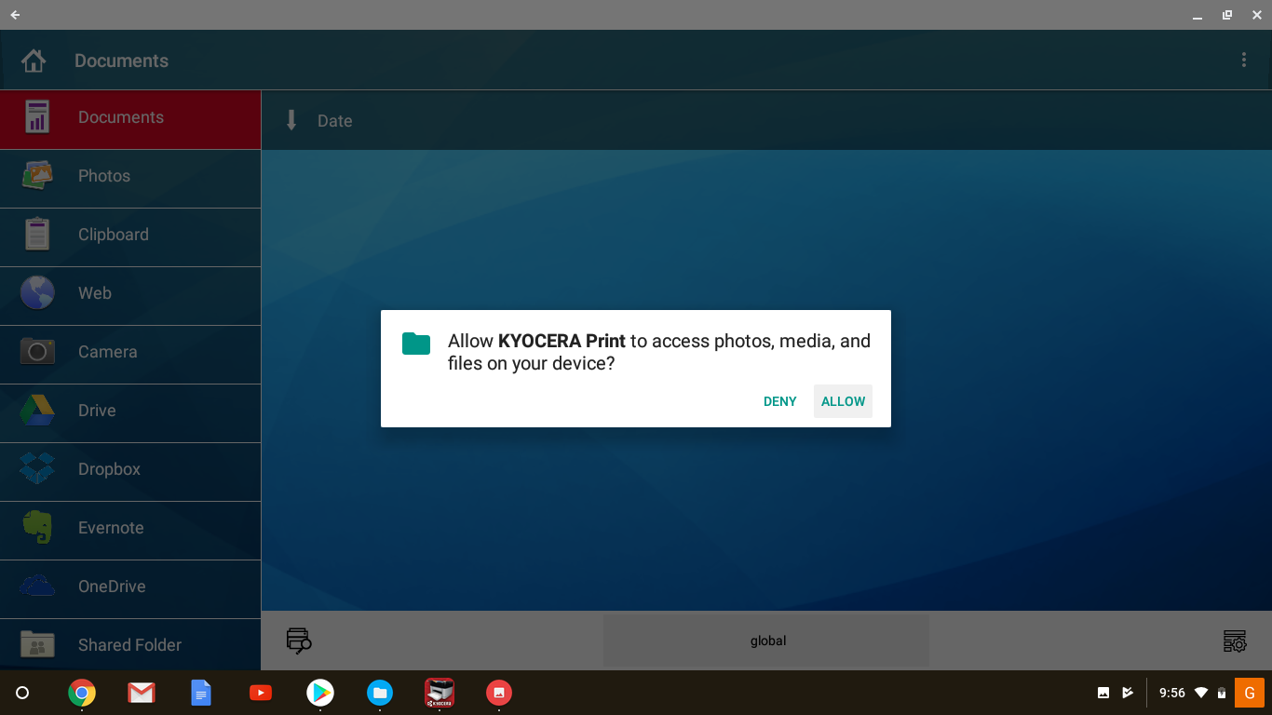
Click on “Allow” to get the access for the application to your data. Choose available document and press print.

Slide 16
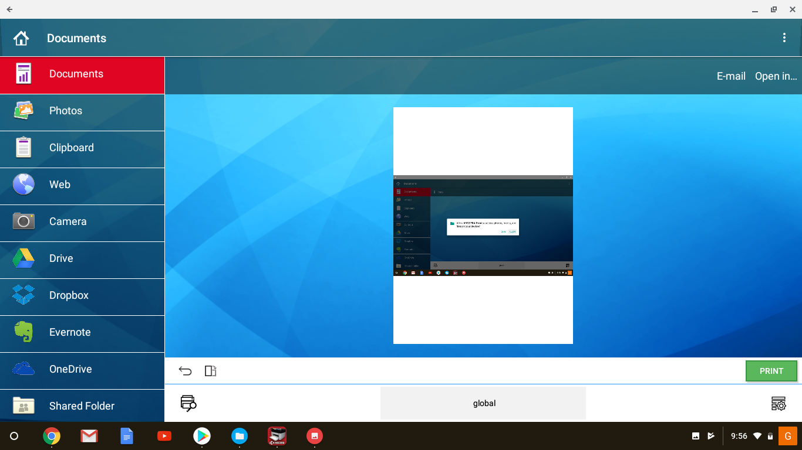
If the document is ready to print, you should see the following window.

