Slide 1
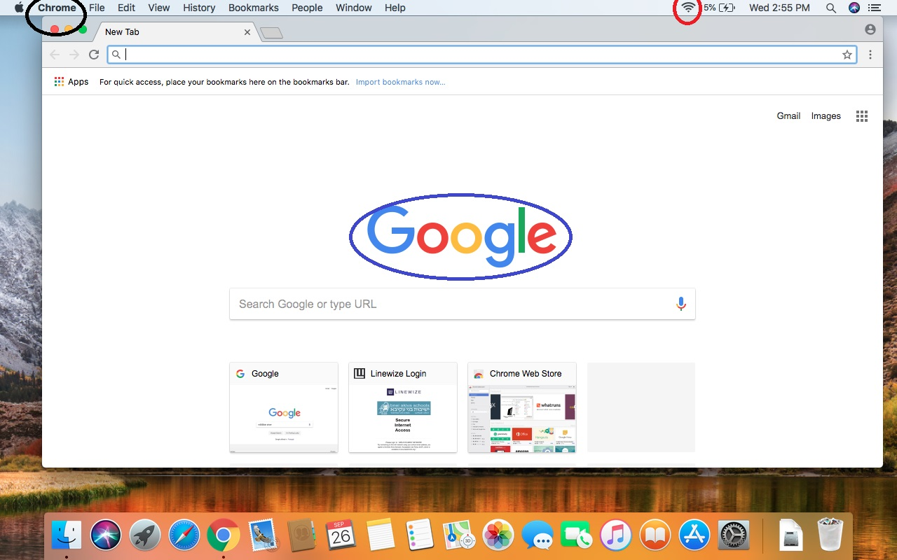
Open any browser. In my case I am using Chrome. Make sure you are connected to the internet. Go to www.google.com

Slide 2
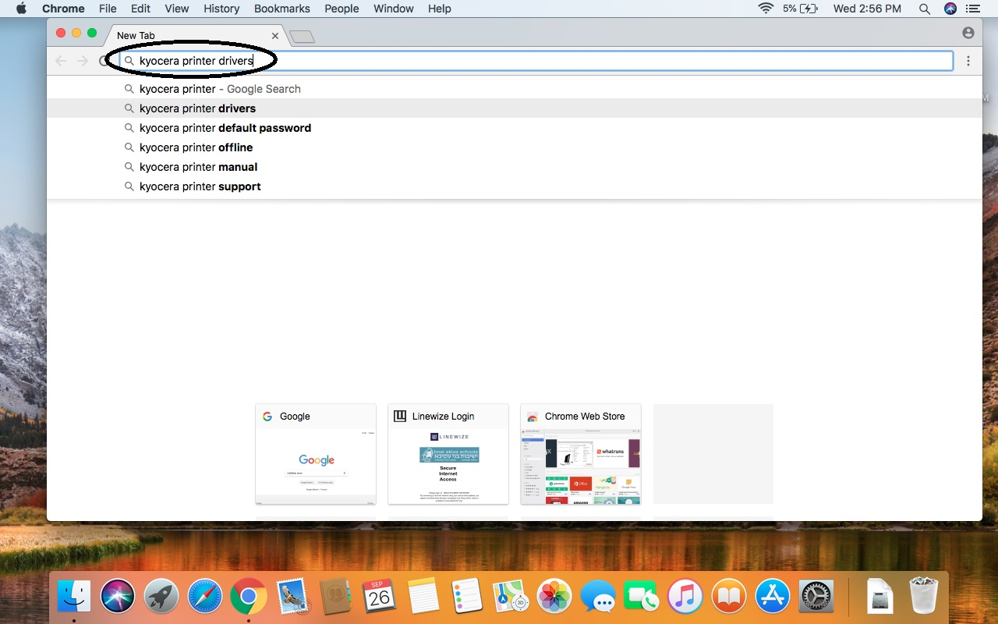
Google for “kyocera printer drivers”.

Slide 3
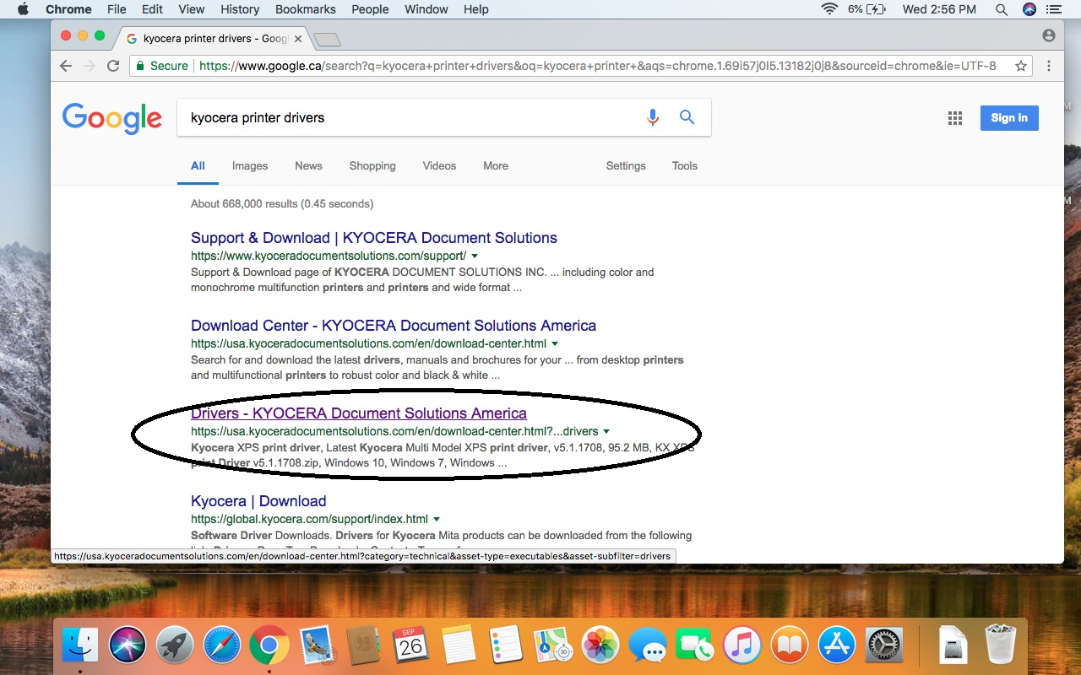
Look for: “Drivers – KYOCERA Document Solution America” Notice: you can use Canadian web-site as well, so google for ca.kyoceradocumentsolution.com

Slide 4
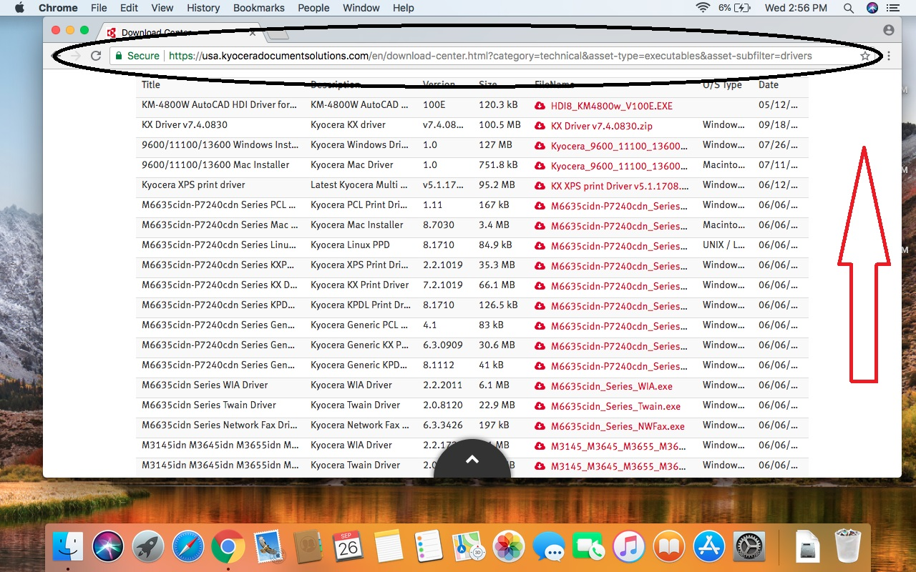
Now you are on the USA Kyocera official web-site. The computer shows you all available drivers. You should narrow down the search. Scroll to the very top of the web-page.

Slide 5
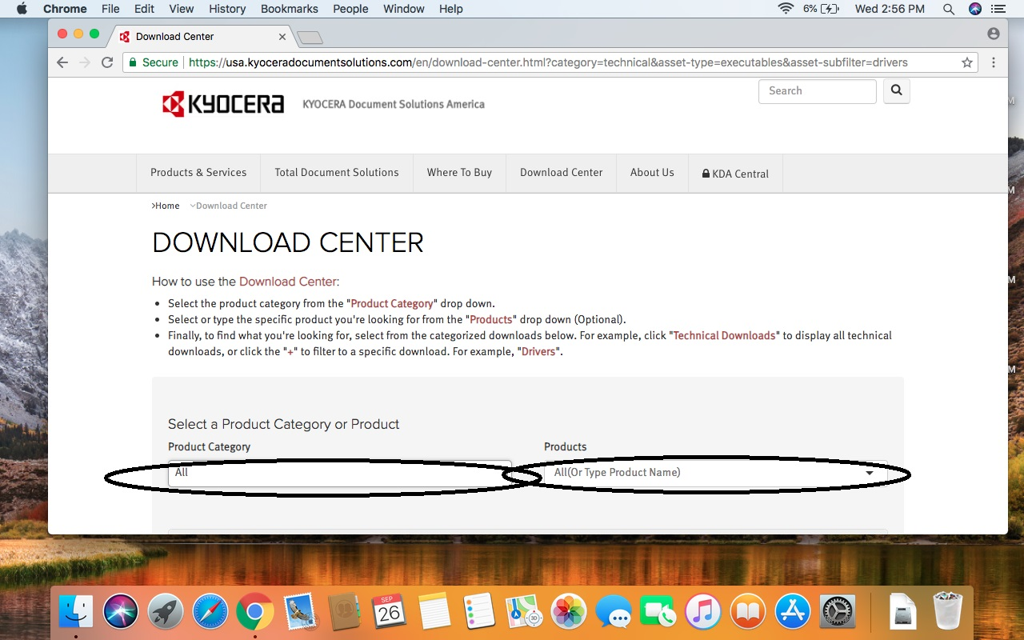
Now you see the top of the “Download Center” web-page. We will narrow down our search by choosing the “Product Category” and the “Product”.

Slide 6
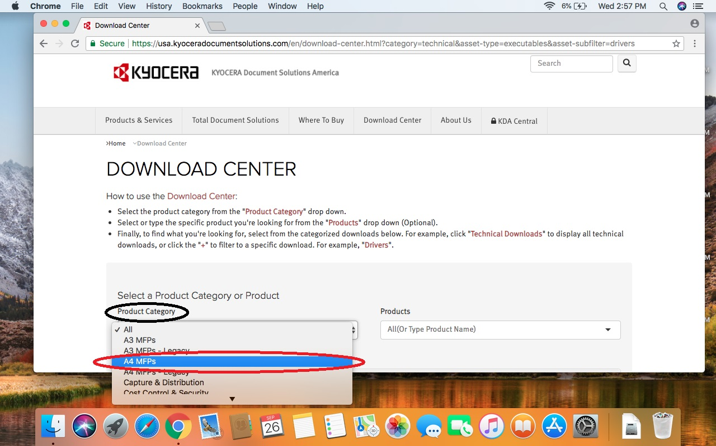
Click on “Product Category” folder. In the pull down menu choose “A4 MFPs”.

Slide 7
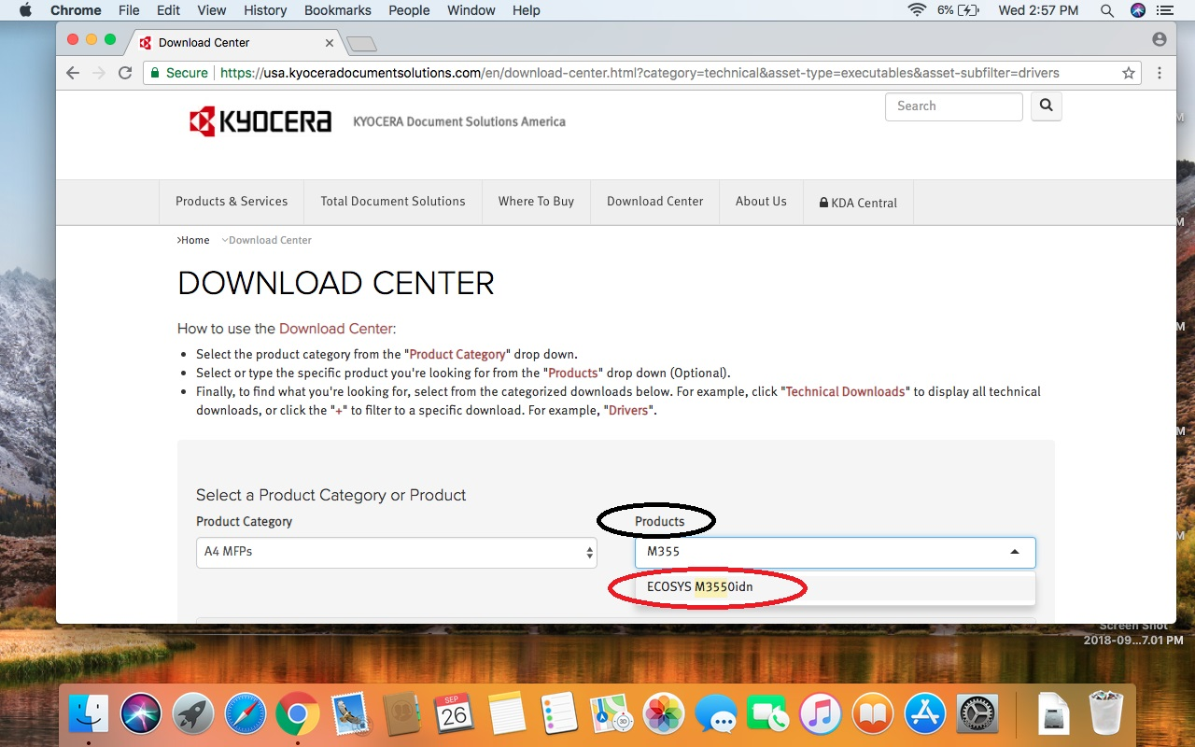
Click on “Product” menu. Type M3550 and choose the ECOSYS M3550idn, or just find ECOSYS M3550idn in the list.

Slide 8
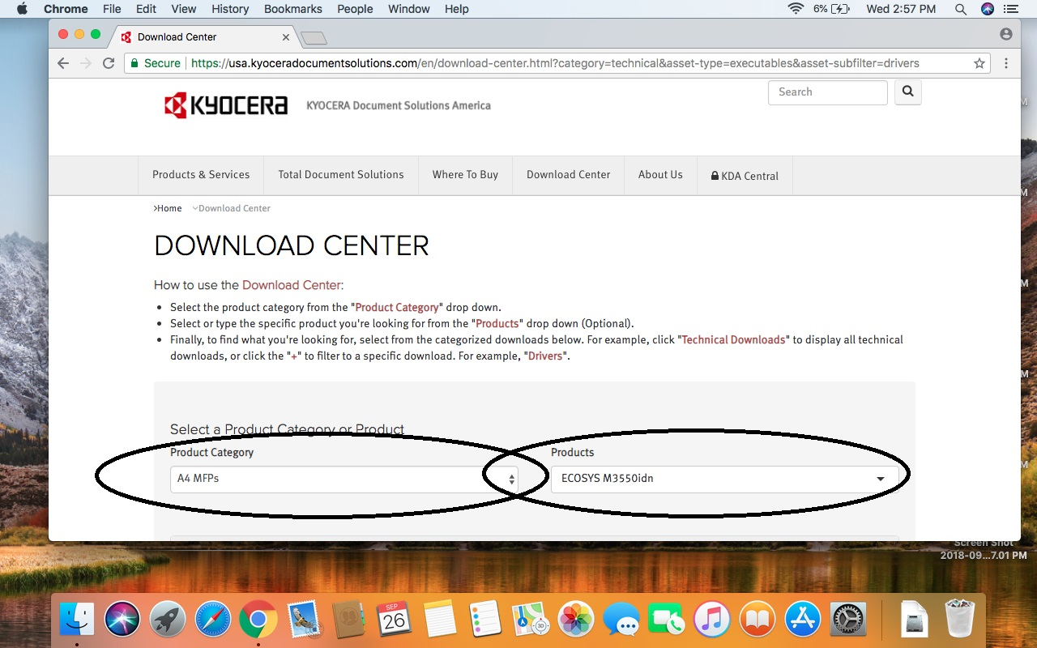
Your search criteria should look like in the example below.

Slide 9
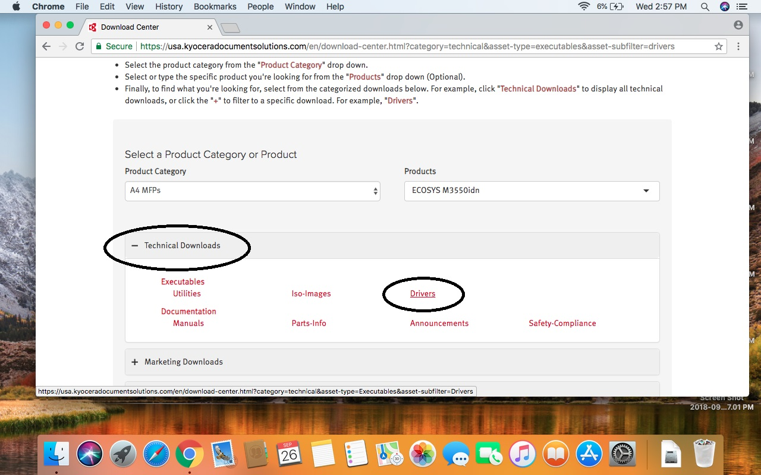
Under “Technical Downloads” at the middle of the page should you see red “Drivers” link. Click on this link.

Slide 10
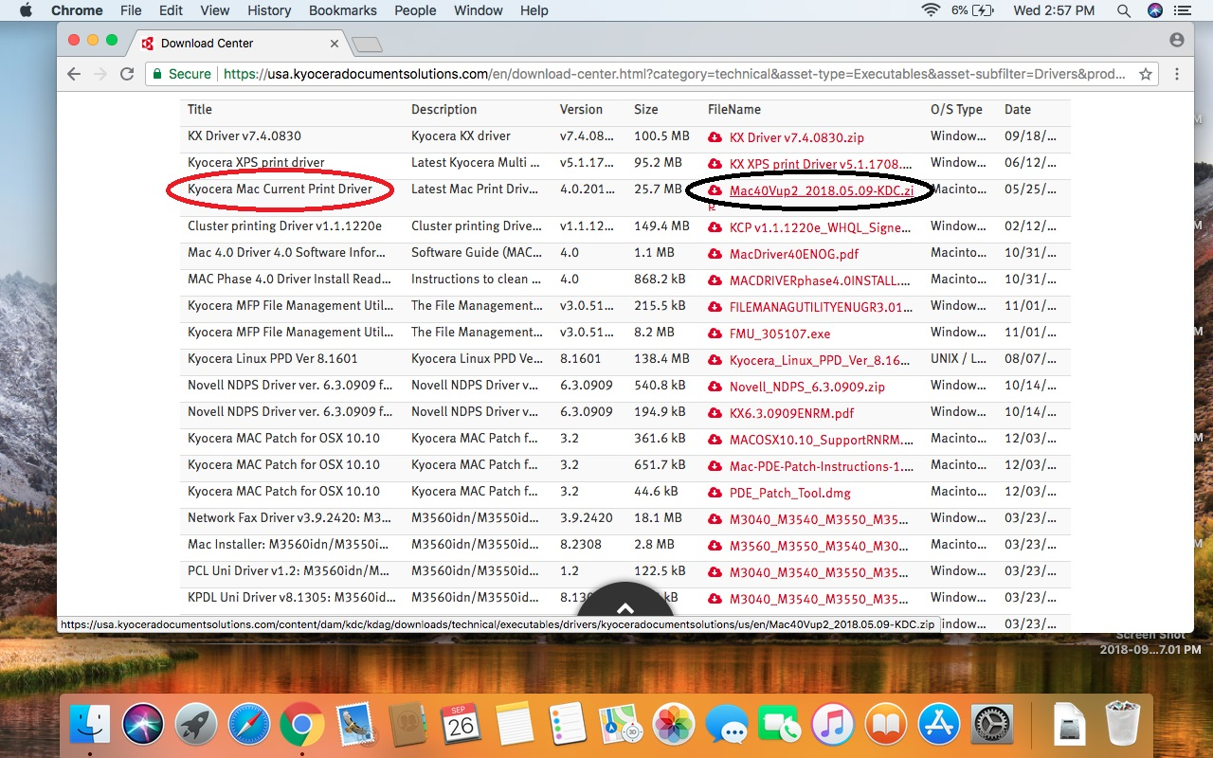
Find “Kyocera Mac Current Print Driver” in the list. Usually it is third from the top. Click on the “cloud” icon to start to download the printer driver.

Slide 11
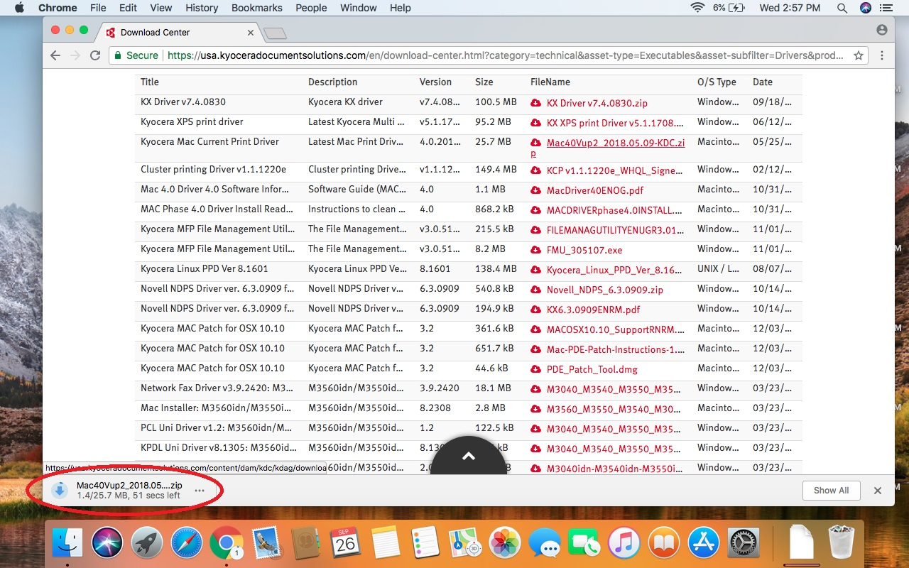
The download process started. Notice: different OS versions shows downloading process differently. For instance, some OS shows downloading process in the upper right corner of the page.

Slide 12
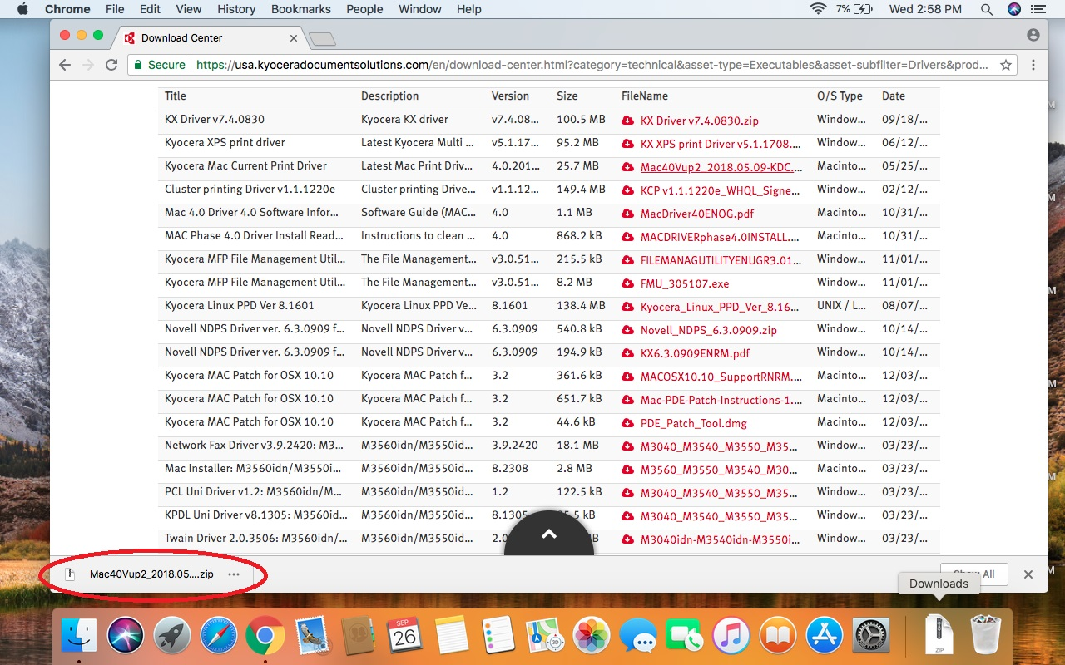
Once the downloading is over, click on the downloaded file. Notice: if you have a different OS your downloaded file is located in the different spot of the screen.

Slide 13
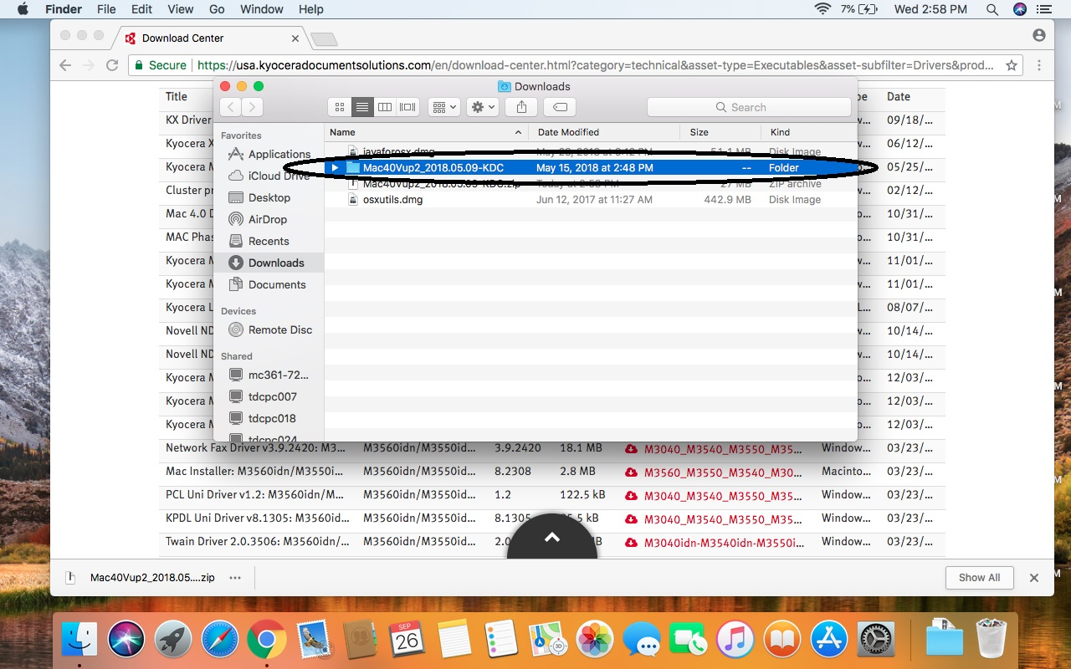
The downloaded file is opened and you see what it is inside. The folder is marked in blue. Click on the folder to open it.

Slide 14
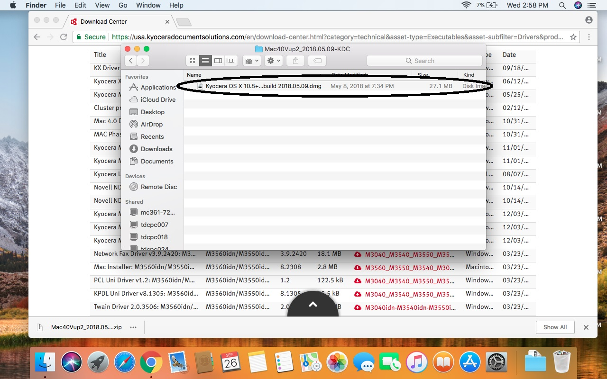
In the folder there is the “Kyocera OS X 10.8+… build..” executable file. Click on it.

Slide 15
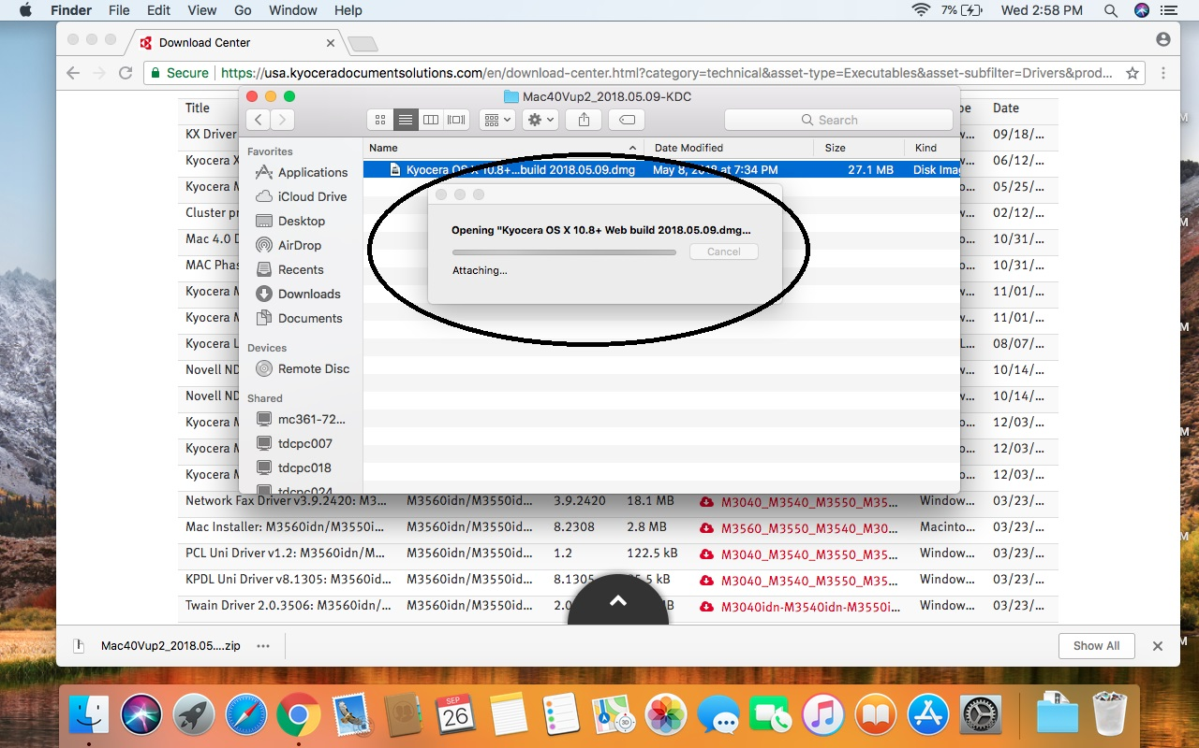
The computer starts to unpack the file. Usually it takes a minute to finish. Wait until the computer shows you another folder.

Slide 16
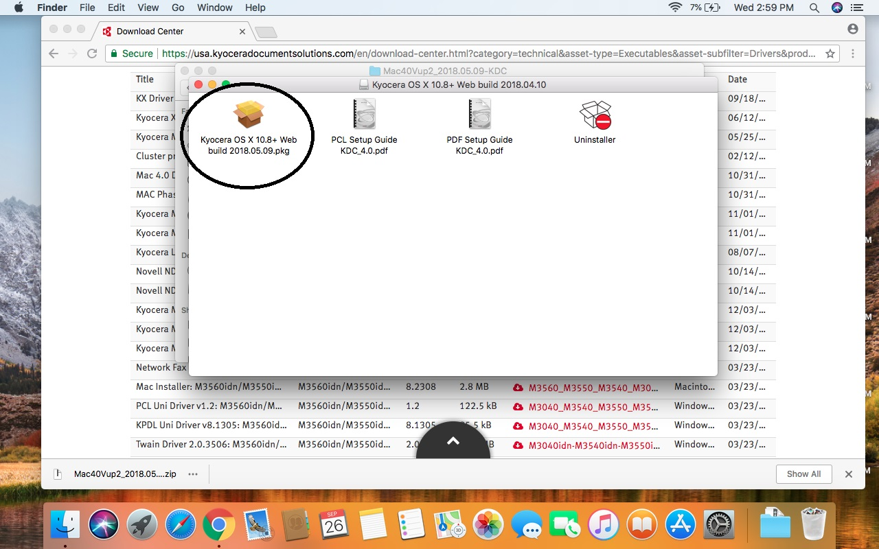
The file was unpacked, and the computer shows you the folder with four files. You need to click on “Kyocera OS X 10.8 + Web build 2018.05.09.pkg” file. Usually it the first one and looks like a box, pkg type of file.

Slide 17
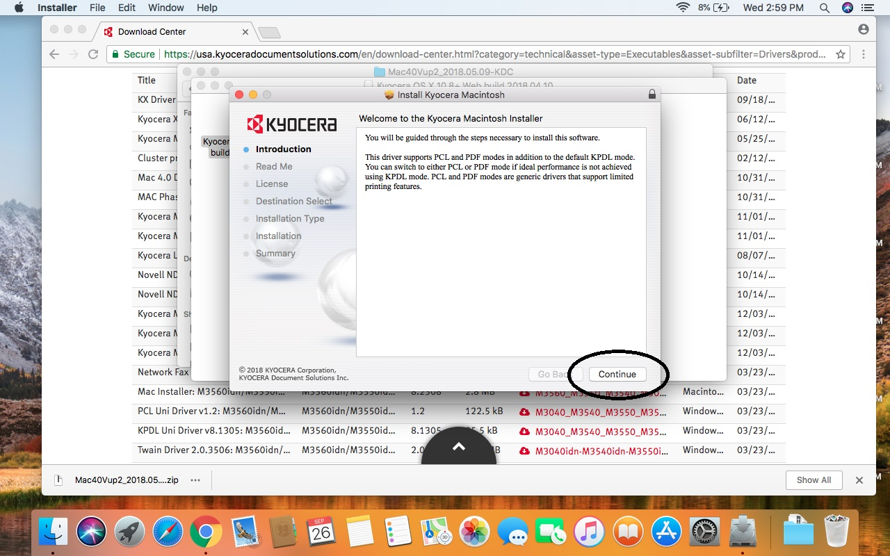
The application is running. Click on “Continue”.

Slide 18
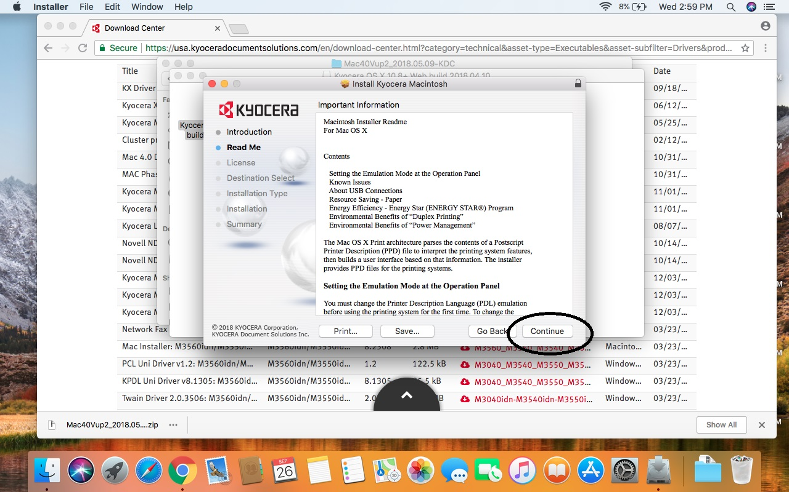
Click on “Continue” again.

Slide 19
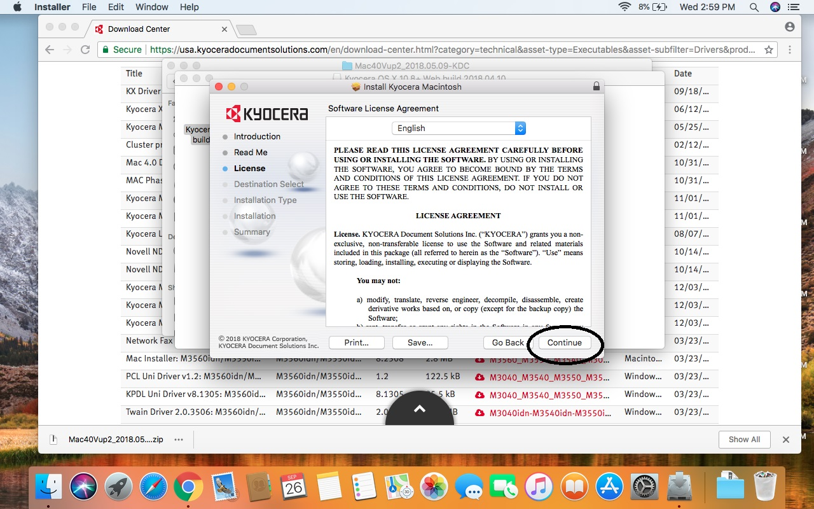
And again click on “Continue”.

Slide 20
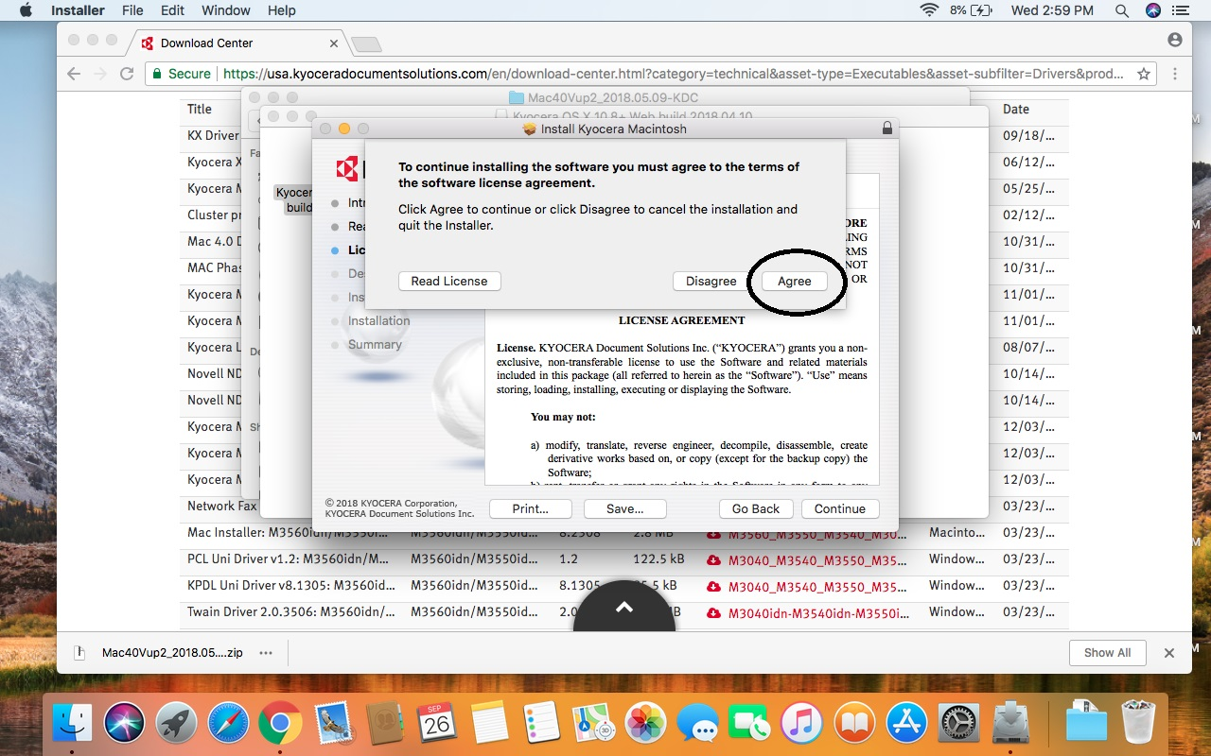
On the page “Software license agreement” click on “Agree”.

Slide 21
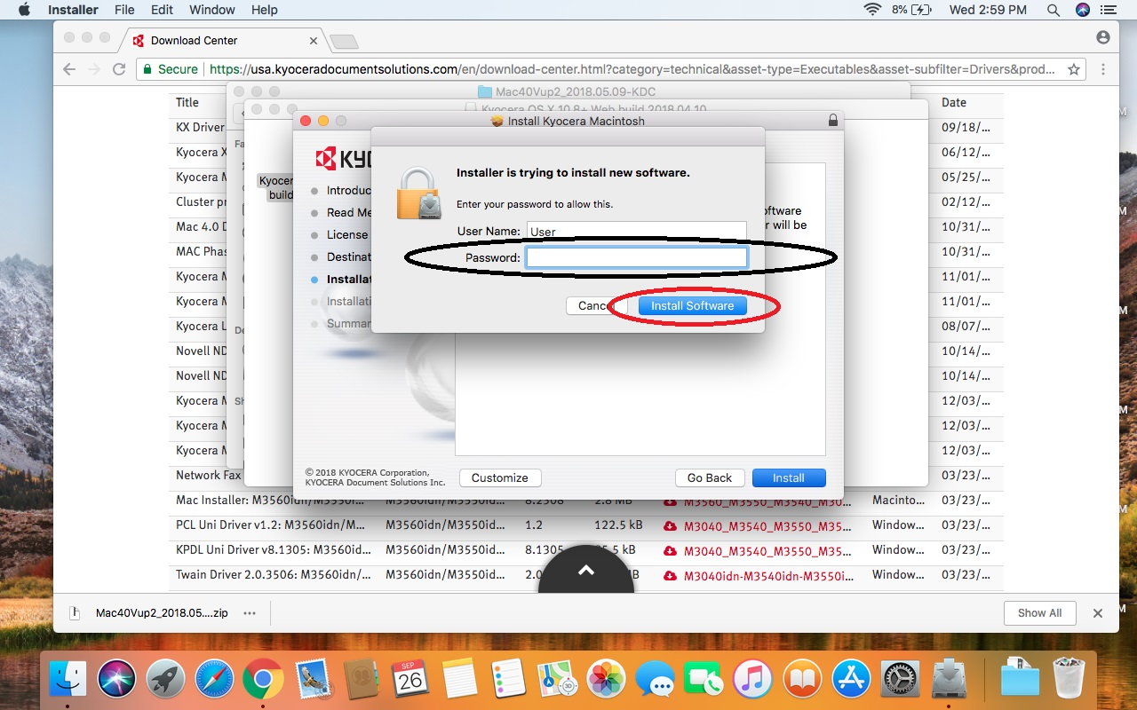
If your computer has a password, you should see this message. Punch in your password. Press “ Install Software”. If your computer is unlocked, just press “Install”.

Slide 22
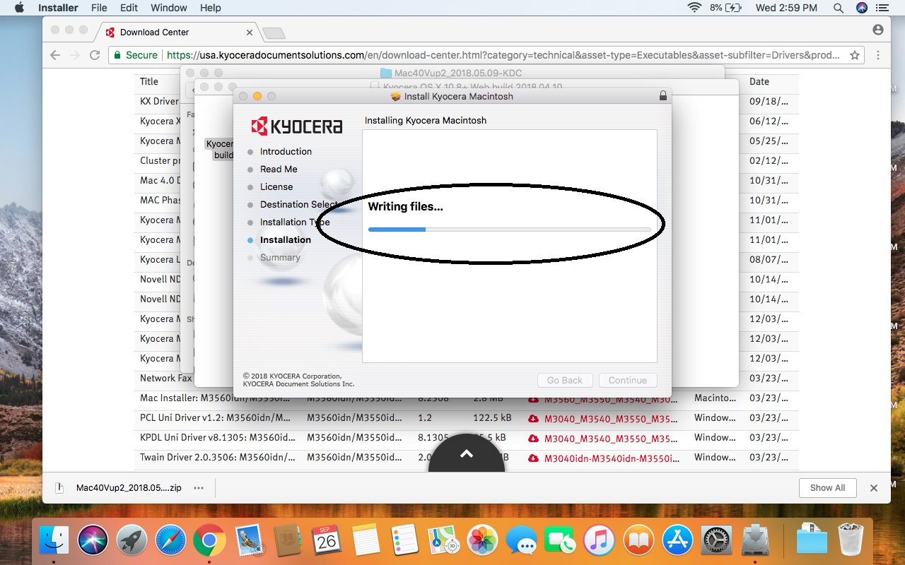
The installation process just started, and it takes less than a minute to finish. Wait until the computer finishes the installation.

Slide 23
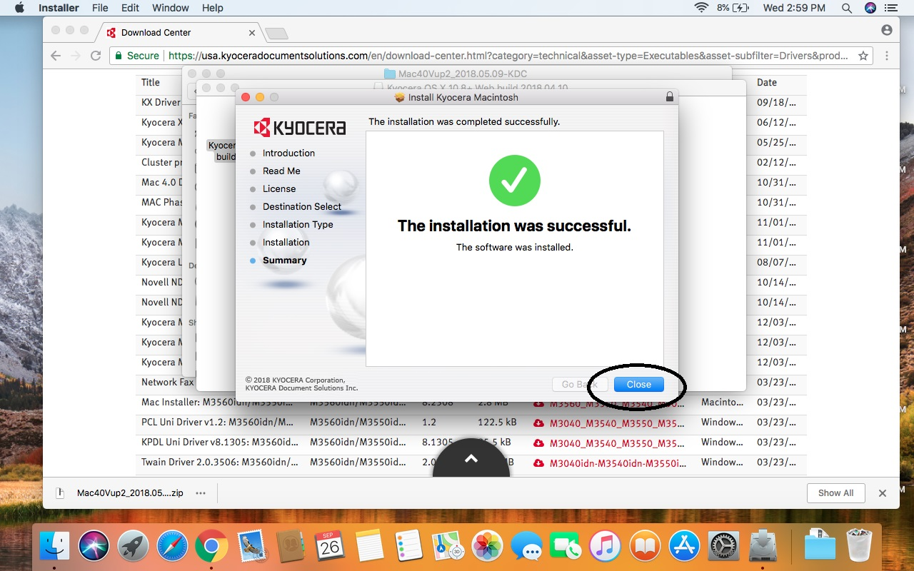
If the installation passed successfully, you should see such a window. Press “Close” button.

Slide 24
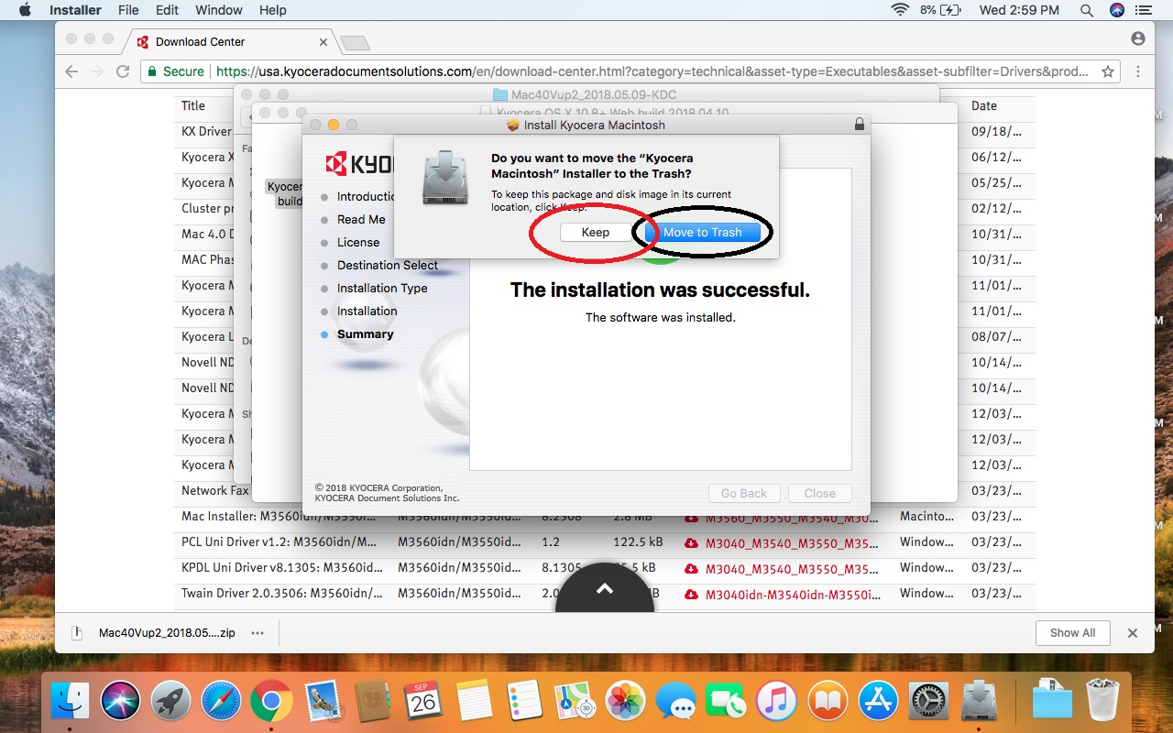
If you do not want to keep the installer file on your computer, press “Move to Trash”. If you want to keep the installer, press on “Keep”. Notice: The driver is already installed, you are not deleting the driver, you are deleting installer unpacked folder.

Slide 25
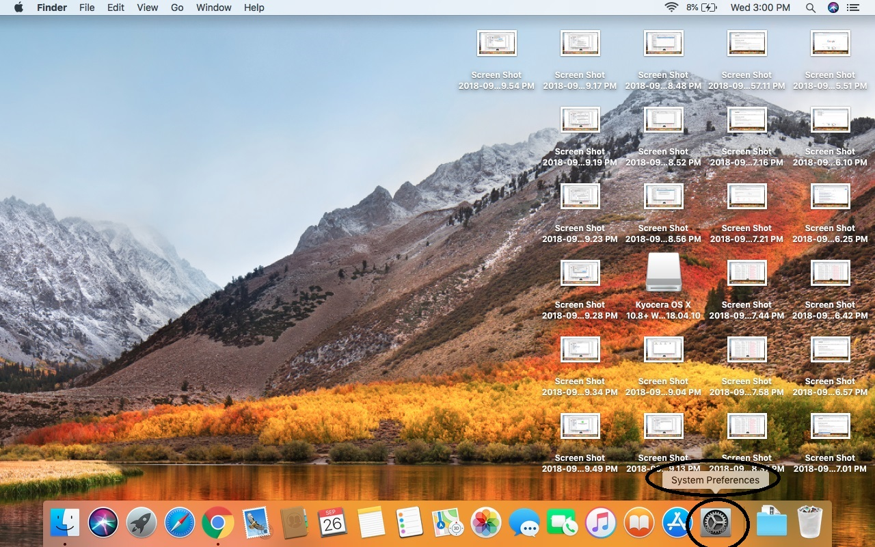
The computer shows you the desktop screen. On the screen find “System Preferences” button. Click on it. Notice: Different OS has different location for System Preferences icon, but the icon looks the same for any version of OS, look for the same icon.

Slide 26
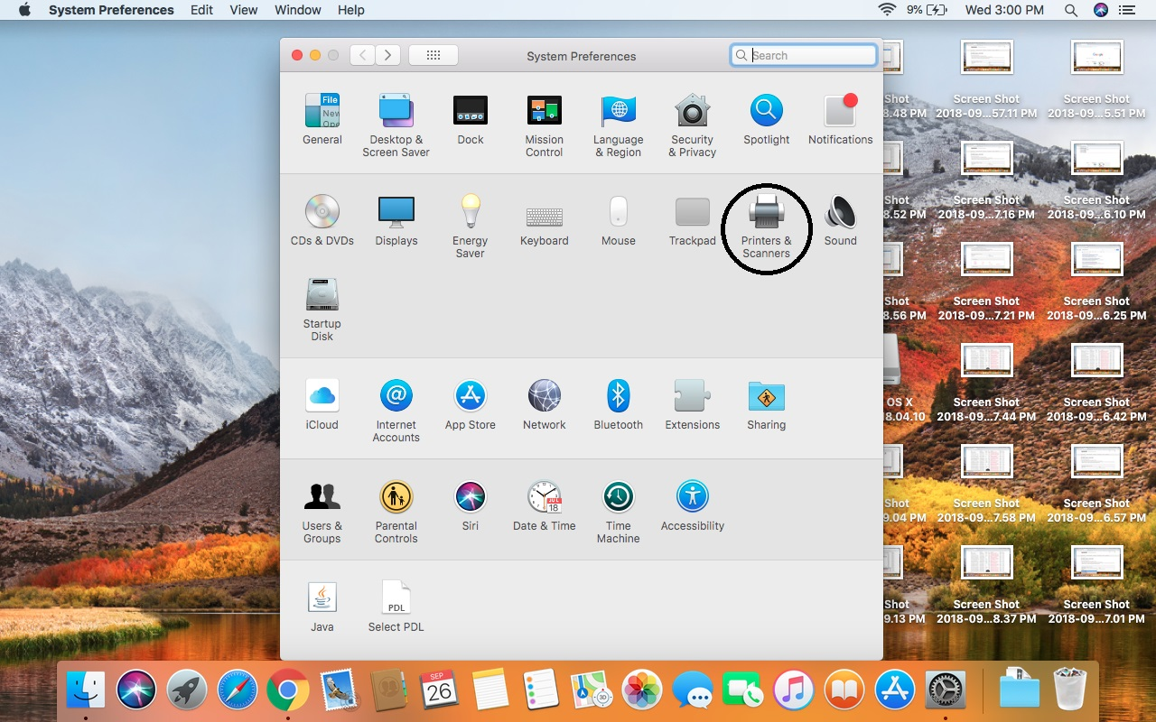
You see the “System Preferences” folder. In the folder look for “Printers & Scanners” icon. Click on it.

Slide 27
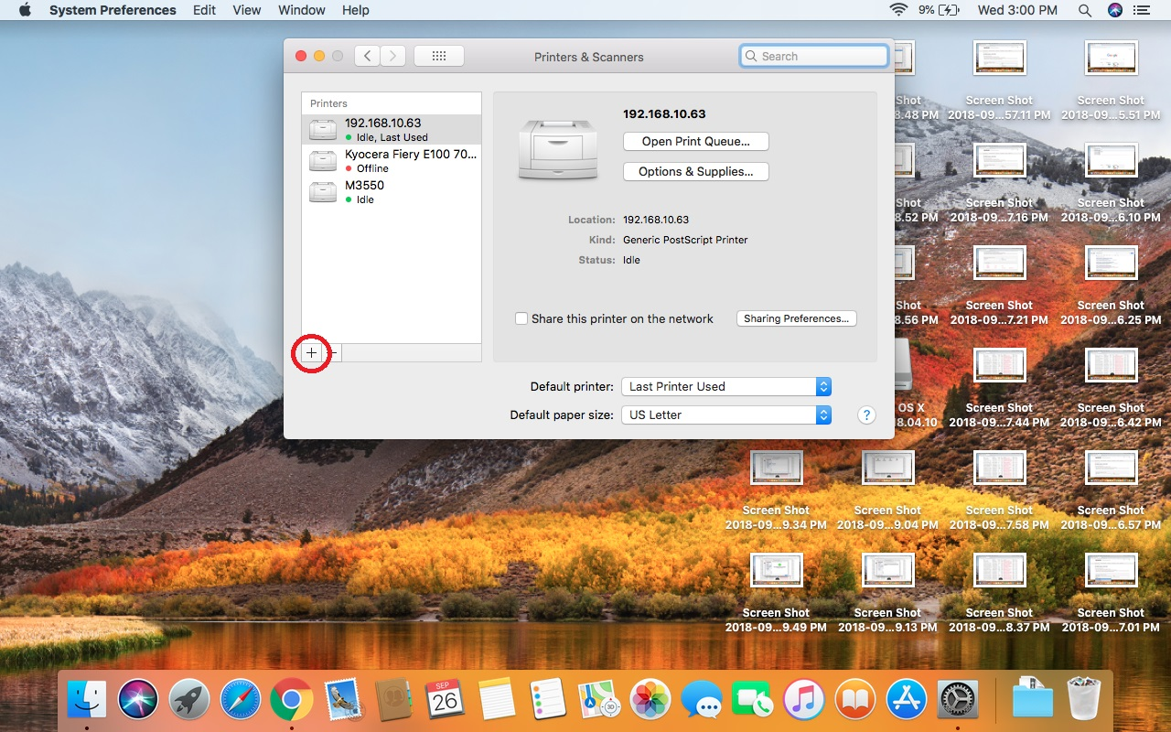
Under “Printers & Scanners” folder, find a plus sign “+”. Press on the plus “+” sign. It is on the bottom left corner of the folder.

Slide 28
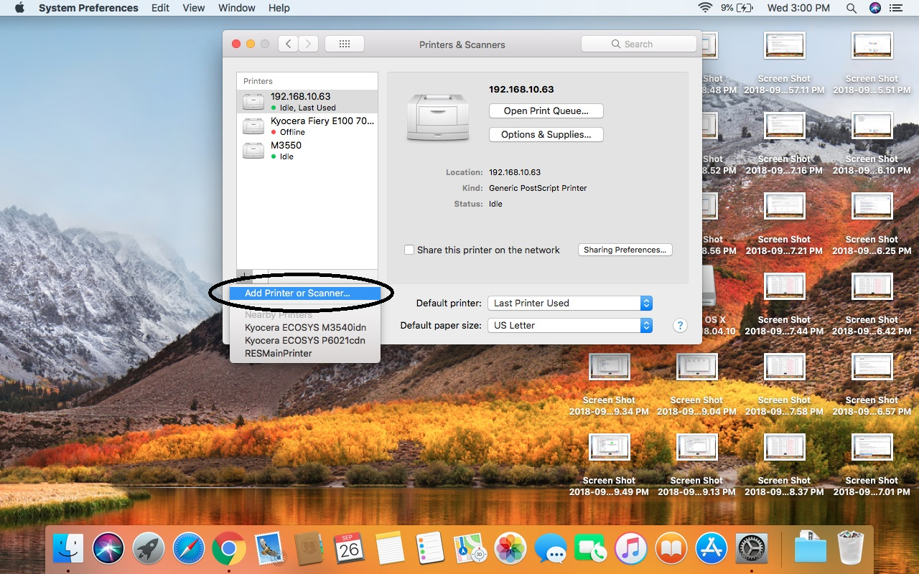
Once you press on the plus sign, you see the pull down menu. In the pull down menu click on “Add Printer or Scanner…” option.

Slide 29
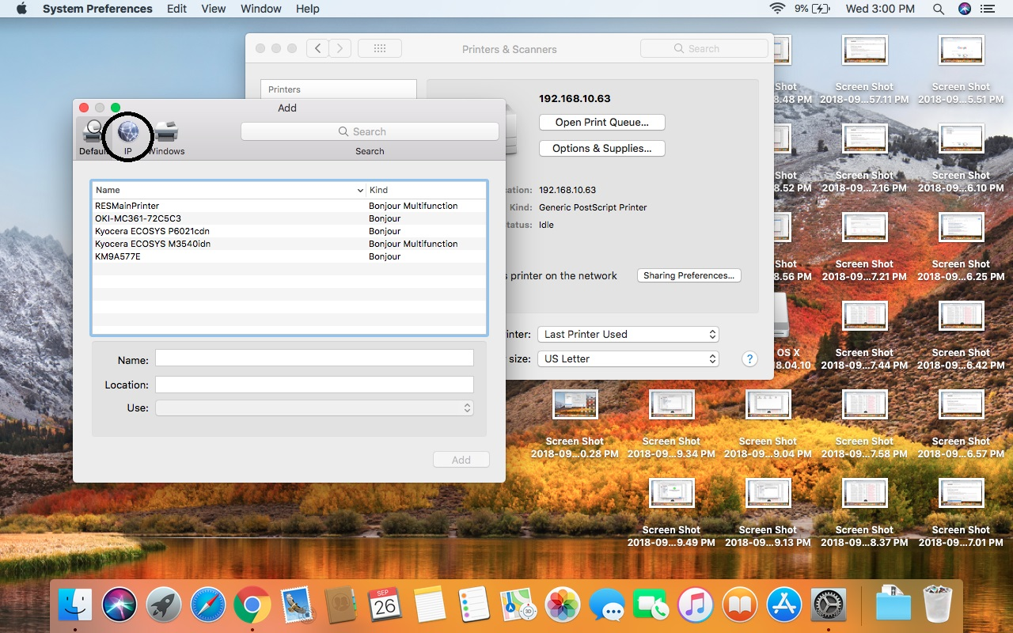
The computer opens another sub-folder “Add”. On the top left corner you see three icons. Choose the “IP” icon, click on it.

Slide 30
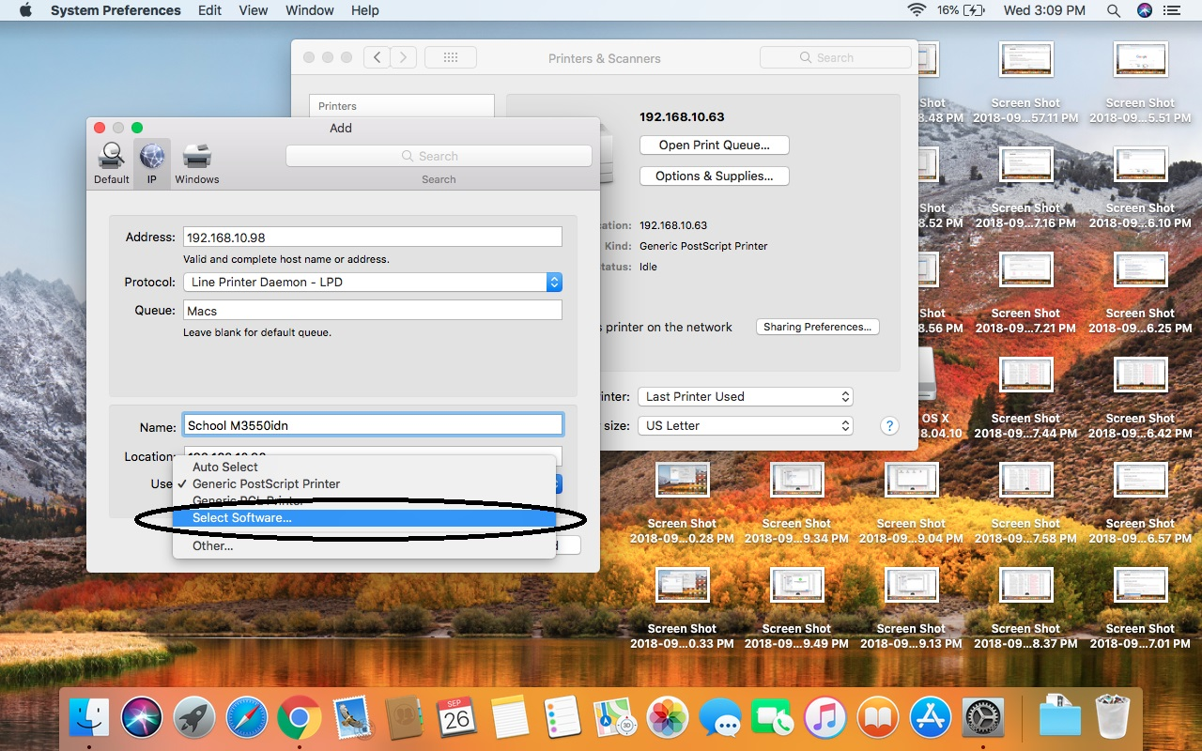
Press on “Use” option, and in the pull down menu choose “Select Software..”

Slide 31
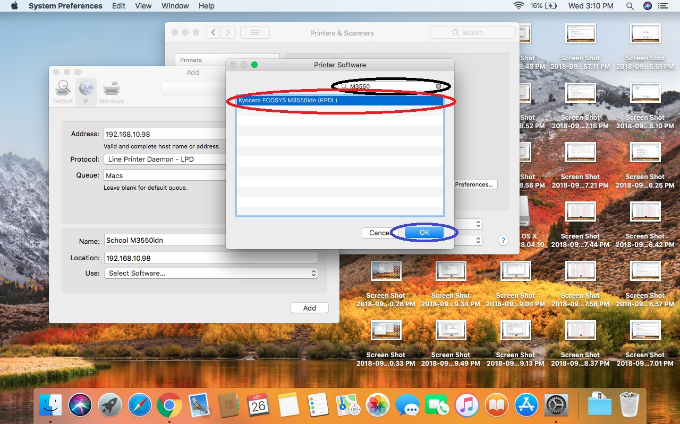
Under “Printer Software” option type “ M3550”. The computer gives you the available drivers that matches your search. Click on “Kyocera ECOSYS M3550 (KPDL)” Click on “OK” button.

Slide 32
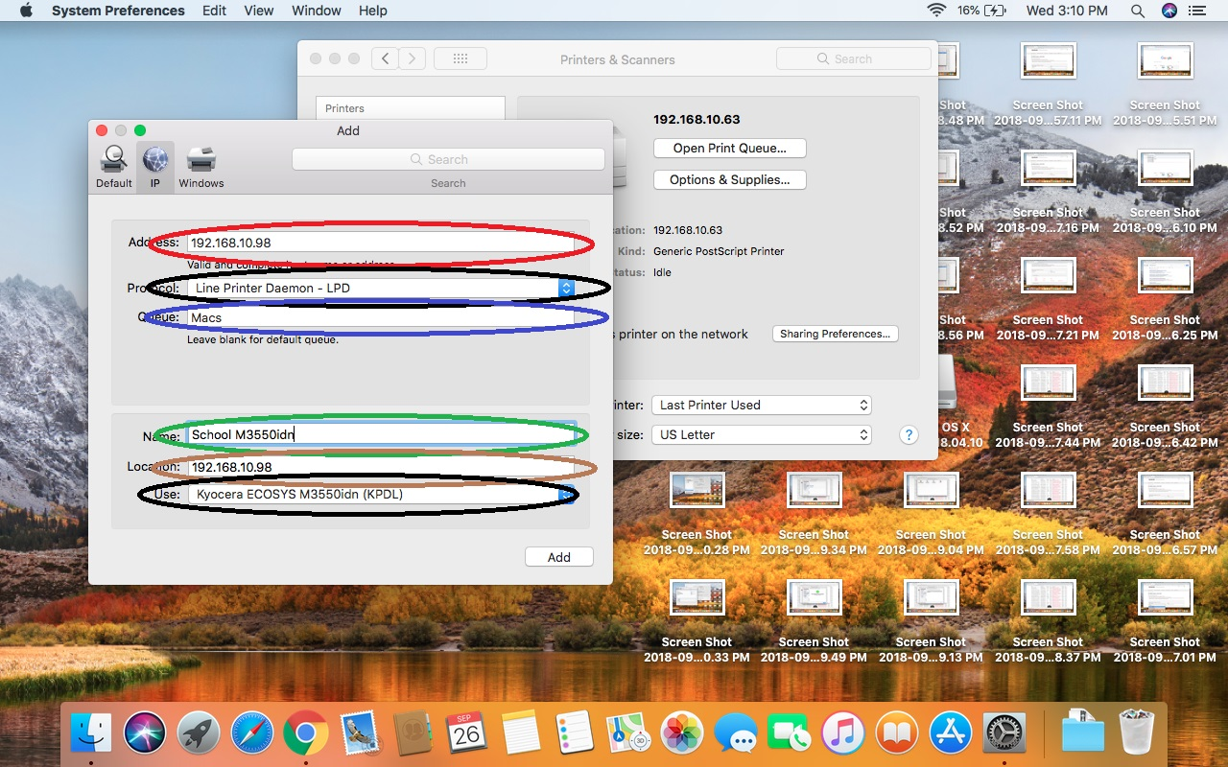
Address: obtain the address from your Tech group. Protocol: choose “Line Printer Daemon – LPD”. Queues: type “Macs”. Name: type “School M3550idn”. Location: repeat the “Address” line, obtain the address from your Tech group. Use: you have chosen it, but make sure that it is “Kyocera ECOSYS M3550idn (KPDL)” CLICK ON “ADD” bottom left corner, if everything is correct in your settings.

Slide 33
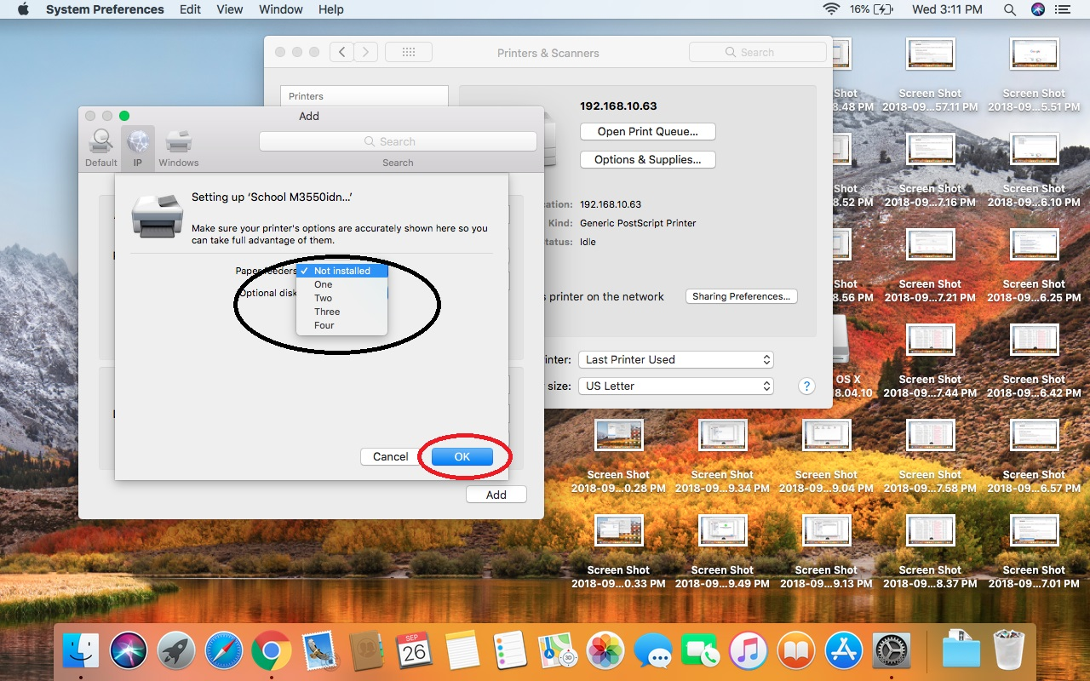
Once you pressed “Add” on the previous page, the computer open the configuration page for your new printer. Under “Paper Feeders” choose two. If you do not know how many additional paper feeders your school printer has, ask your Tech group.

Slide 34
So your screen should look like this one. Click on “OK”. Click on “Add”.

Slide 35
Finishing the printer setup
At this moment we just finished the setting up your school printer M3550idn.
Open any text file or a web-page. Press command P to print the file.
Choose the “School M3550idn” printer.
Print your file in to this printer.
Notice: you will not be able to take your prints right now. The tech group will obtain the information that you computer just sent, update the system adding your name in it. Only after that you will be able to get your prints. The first printed file is only for registering purpose.

Slide 36
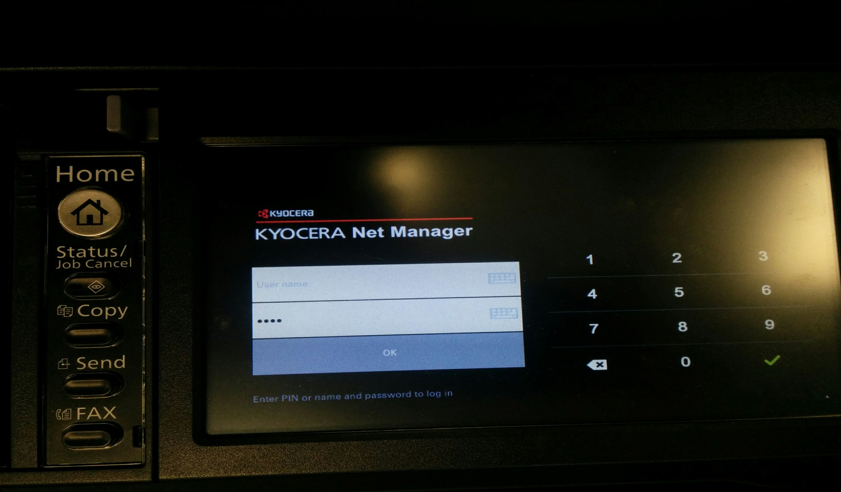
How to log in to the printer. Come to the actual printer and punch your ID. Press “OK” or the green arrow. Notice: you should obtain your ID from your school management or from your Tech group.

Slide 37
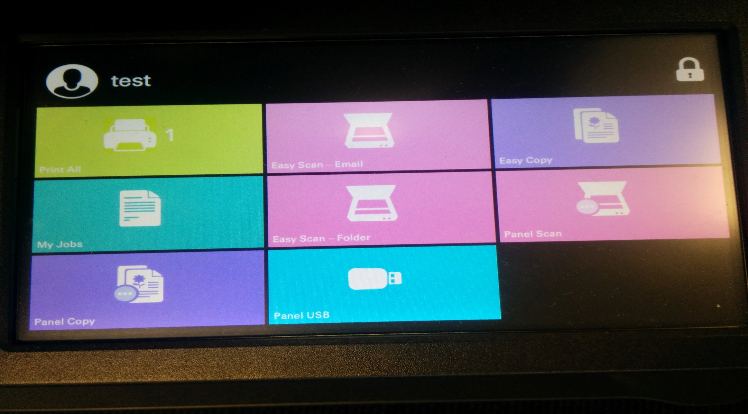
Once you logged into the printer, you should see this screen with your name in the upper left corner and “Print All” with “1”. If you see it, means the setup was done properly. Notice: allow the Tech group to update the system with your new information that you sent with the test file. Your should be able to print and see the print jobs on the net day

