Slide 1
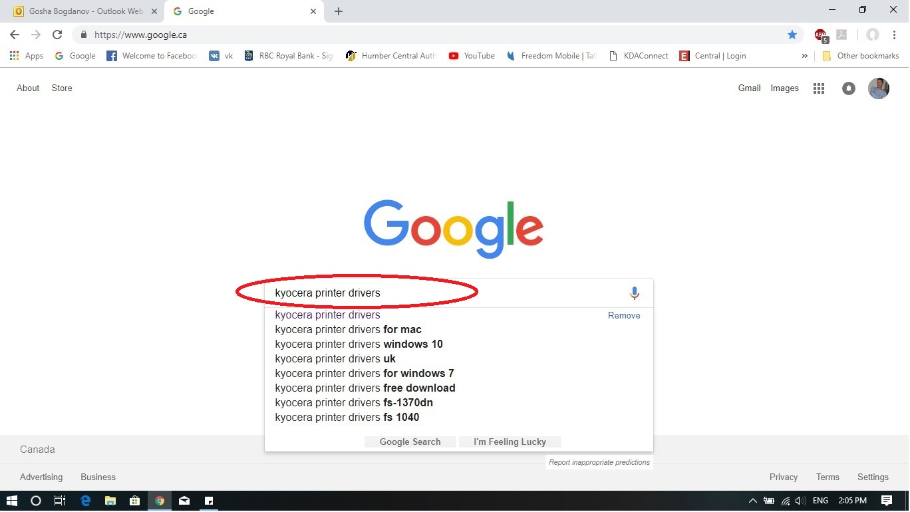
Start your computer, open any browser and Google for Kyocera printer driver.

Slide 2
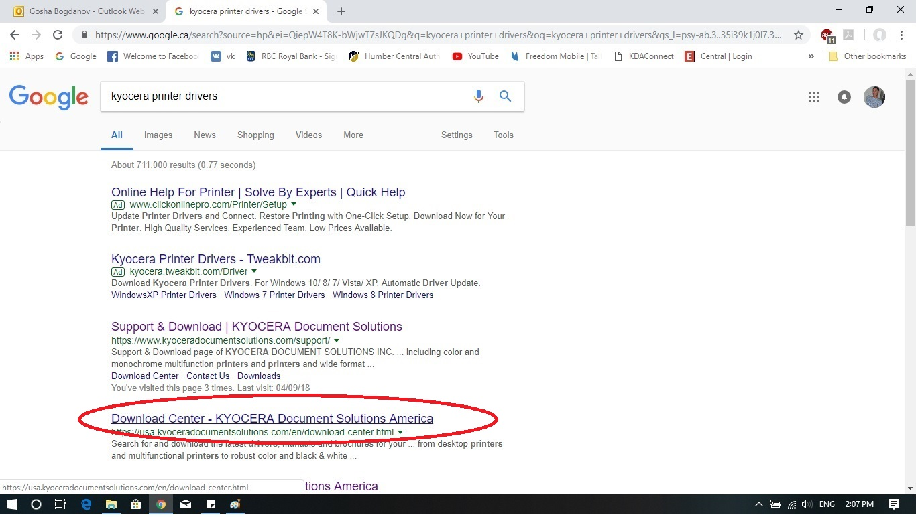
The computer gives you the suggested web-sites. Choose the “Download Center – Kyocera Document Solution America”. On this example it is fourth from the top.

Slide 3
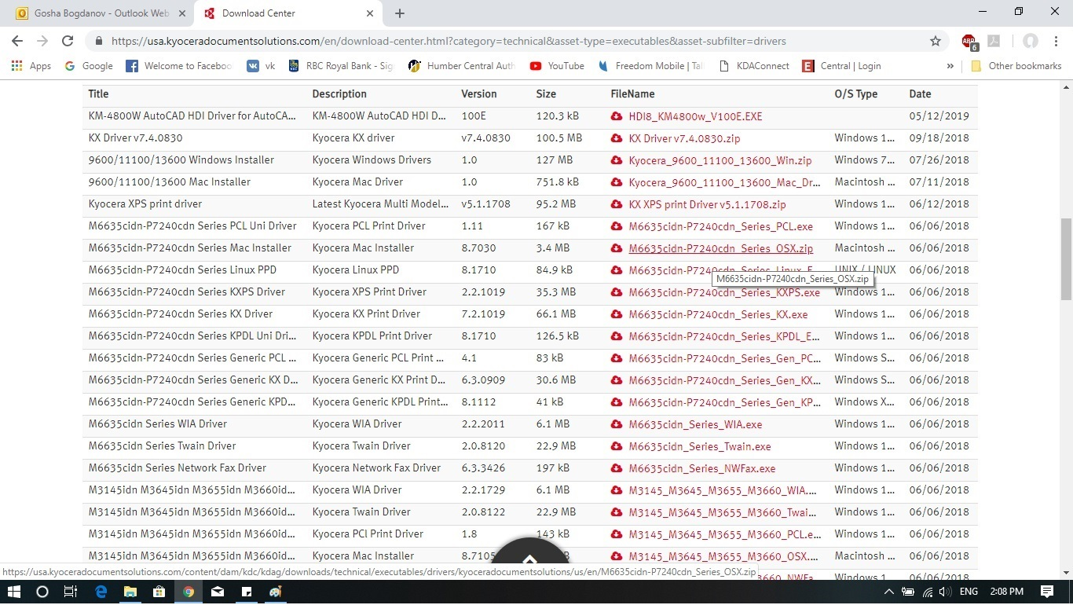
The browser will show you the middle of the page, so you need to scroll the page up to the very top!!!

Slide 4
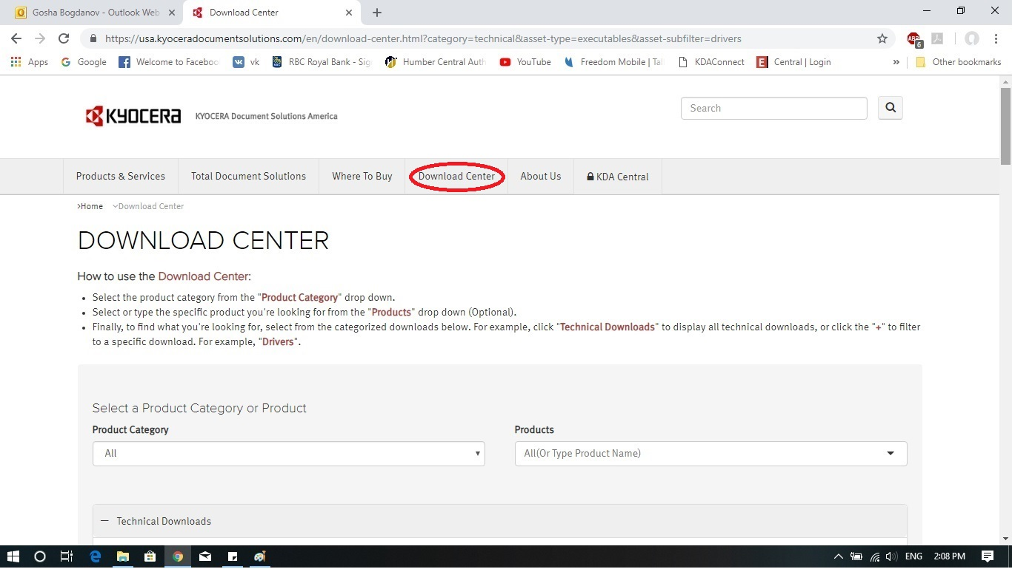
This is the top of the page! Press “Download Center” button.

Slide 5
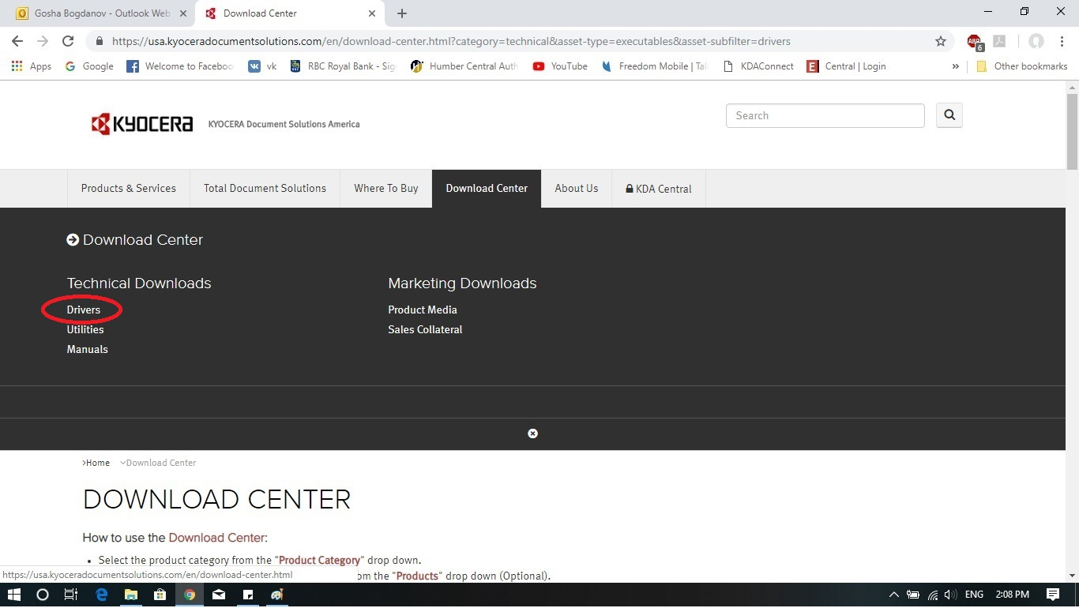
After you pressed the “Download Center” button, the pull down menu pops up. Press on the “Drivers” link.

Slide 6
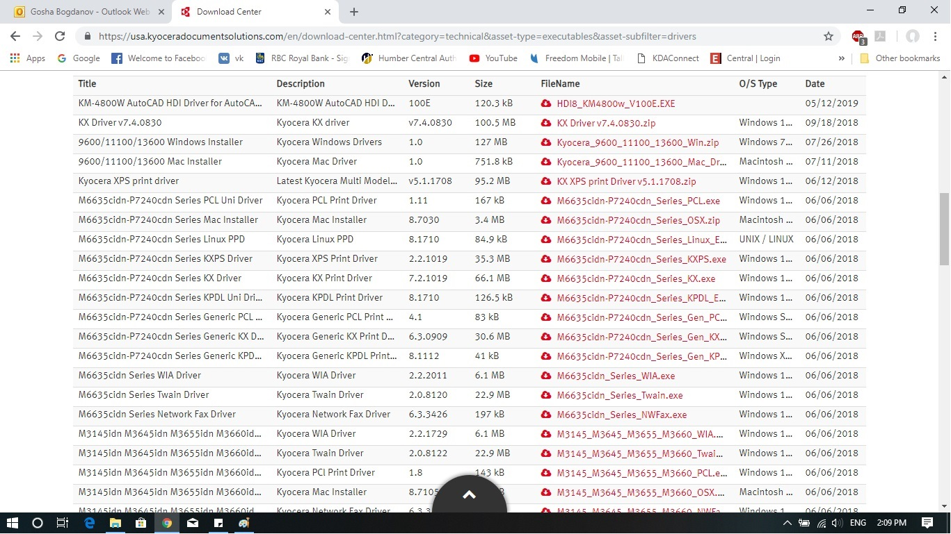
Once you pressed “Drivers”, the Download Center shows you the available drivers. Scroll to the top of the page again to specify your search.

Slide 7
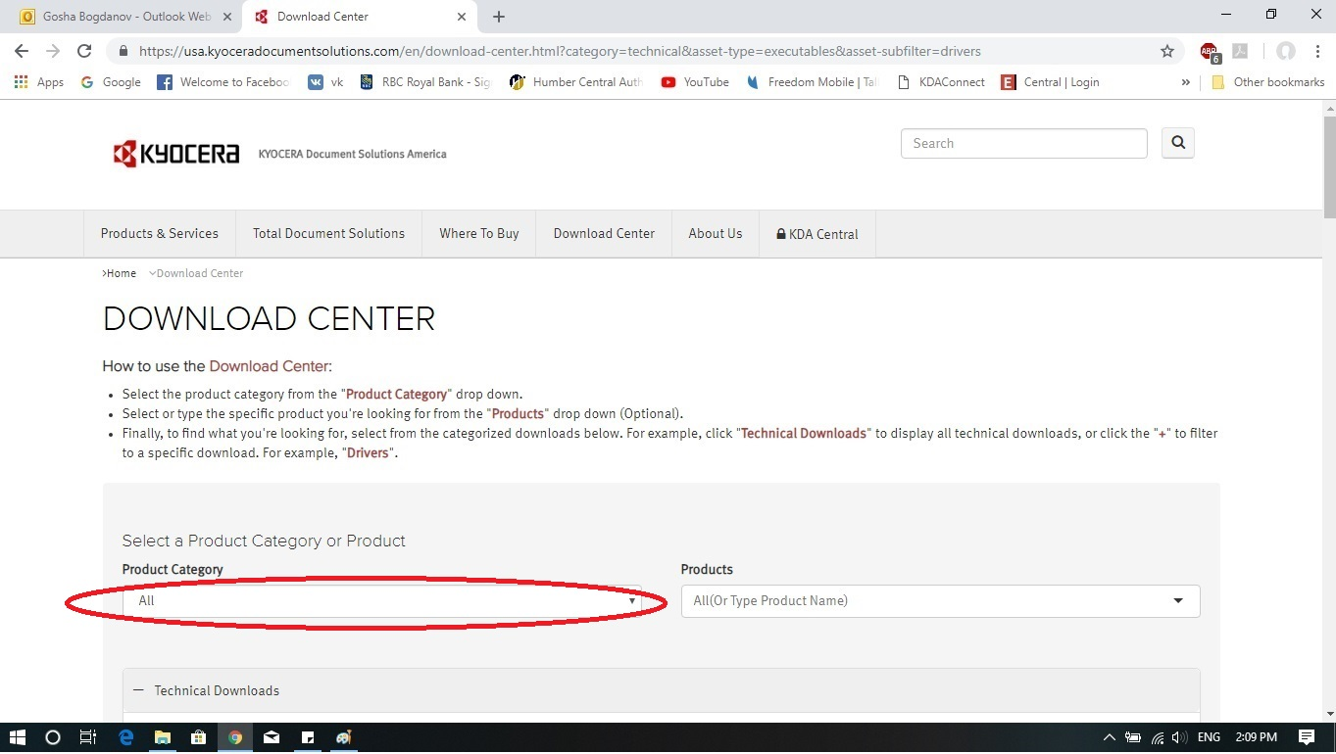
After you scrolled up, under “Product Category” choose “A4 MFPs”.

Slide 8
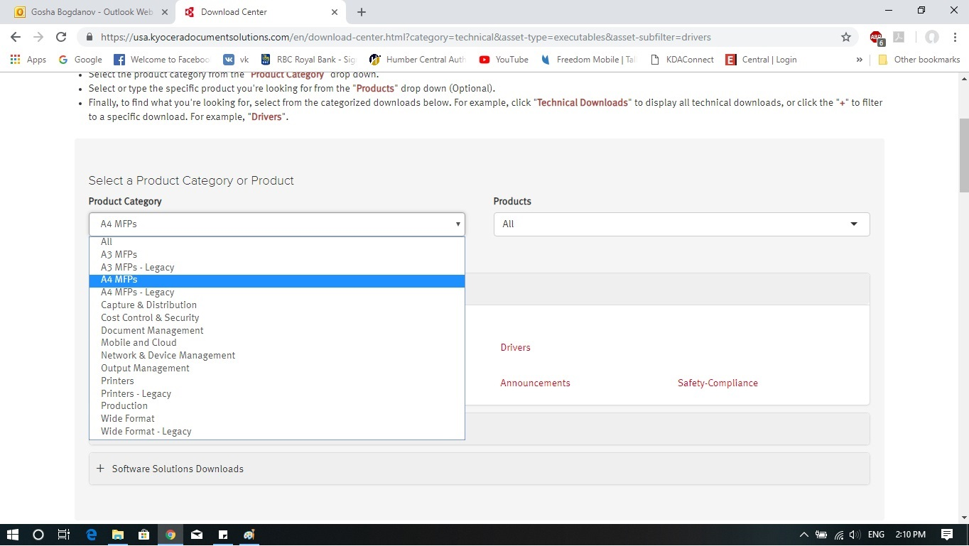
“A4 MFPs” has to be chosen under “Product Category”

Slide 9
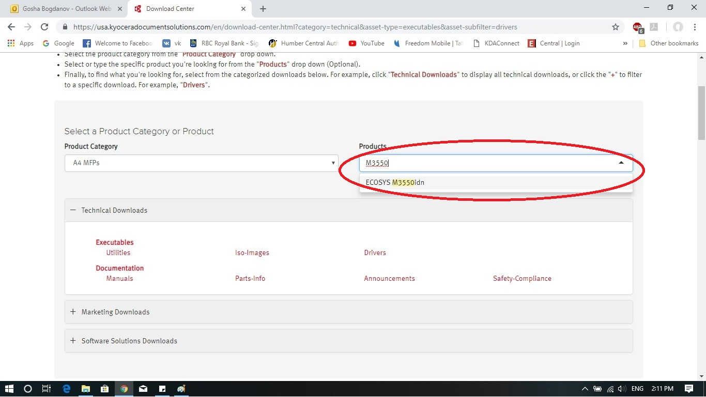
Under Products, type M3550 and choose Ecosys M3550idn

Slide 10
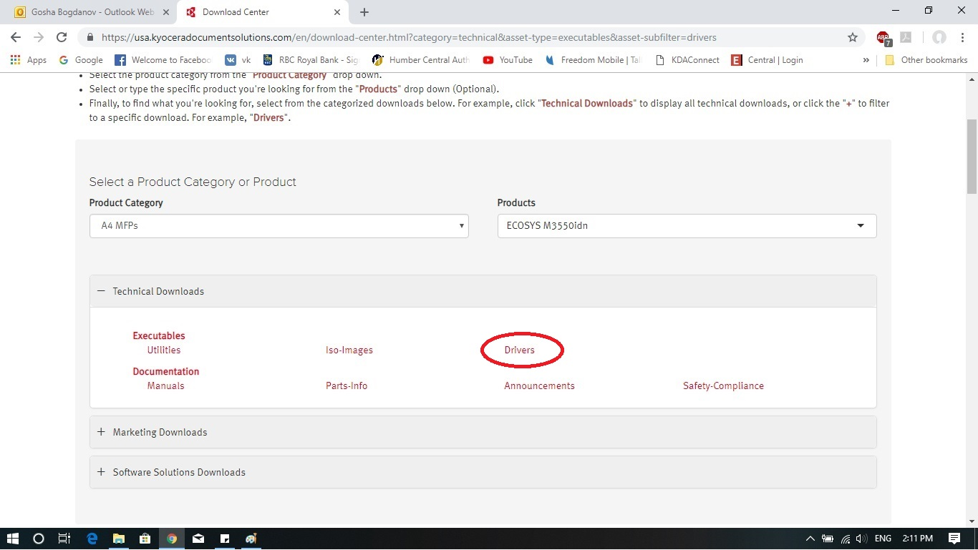
We just finished the narrowing down the search. Press “Drivers” link now.

Slide 11
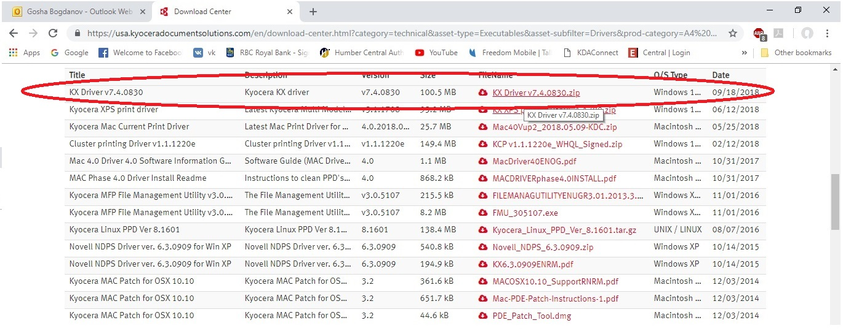
The screen rolls down showing the available drivers. Please, choose KX Driver v7.4.0830. Usually it is the first one in the list. And press the “cloud” icon to download the file.

Slide 12
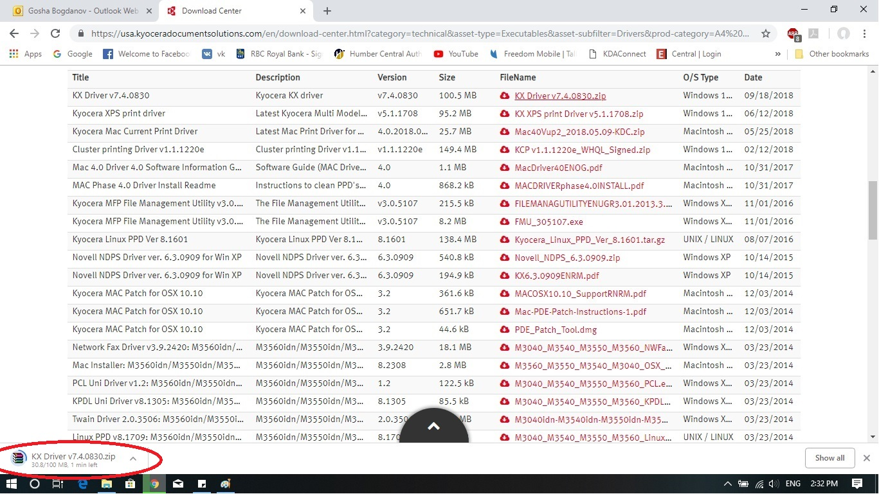
After you pressed to download the driver, you will see the status of the process. Notice, for different versions of Windows the download status looks different.

Slide 13
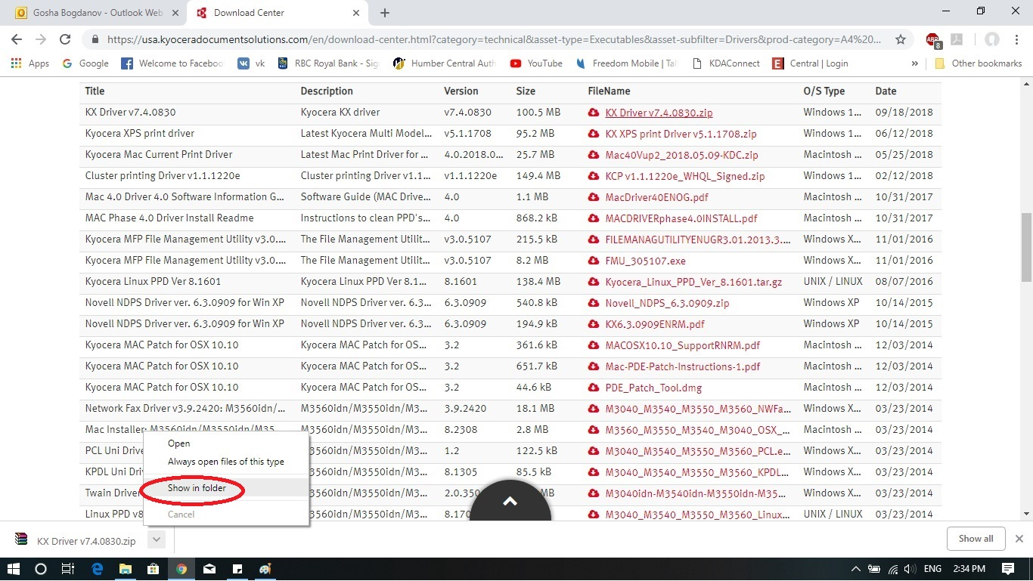
Once the download process is finished, right click on the icon and choose “Show in folder”. The computer shows you the folder and the file that you just downloaded.

Slide 14
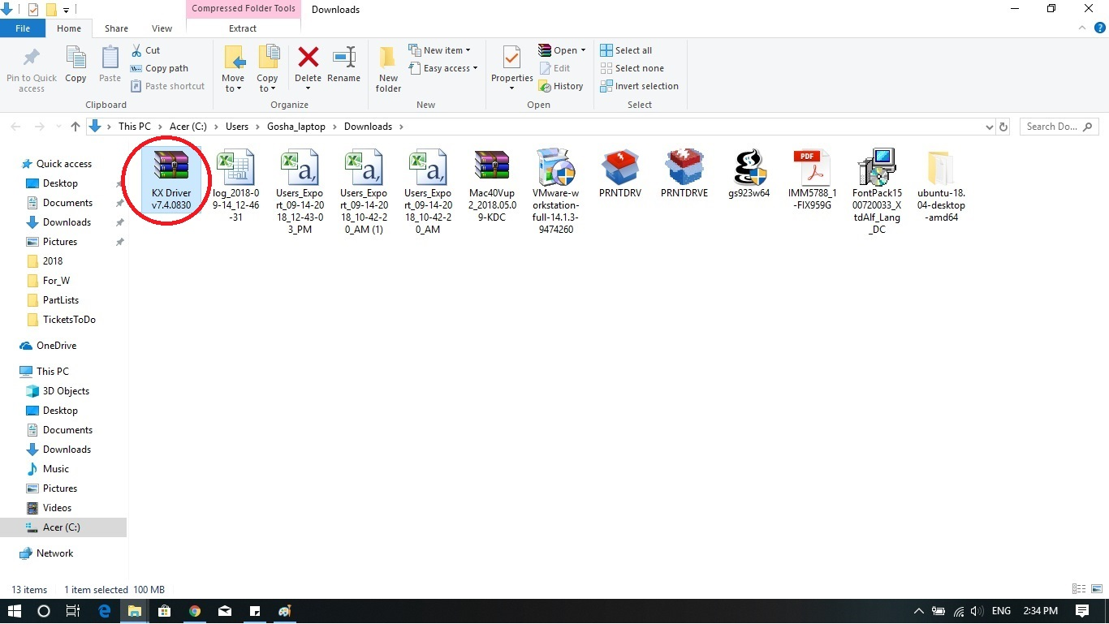
By default the folder is “downloads”. The downloaded file is marked for you. Find this file in your folder and right click on it.

Slide 15
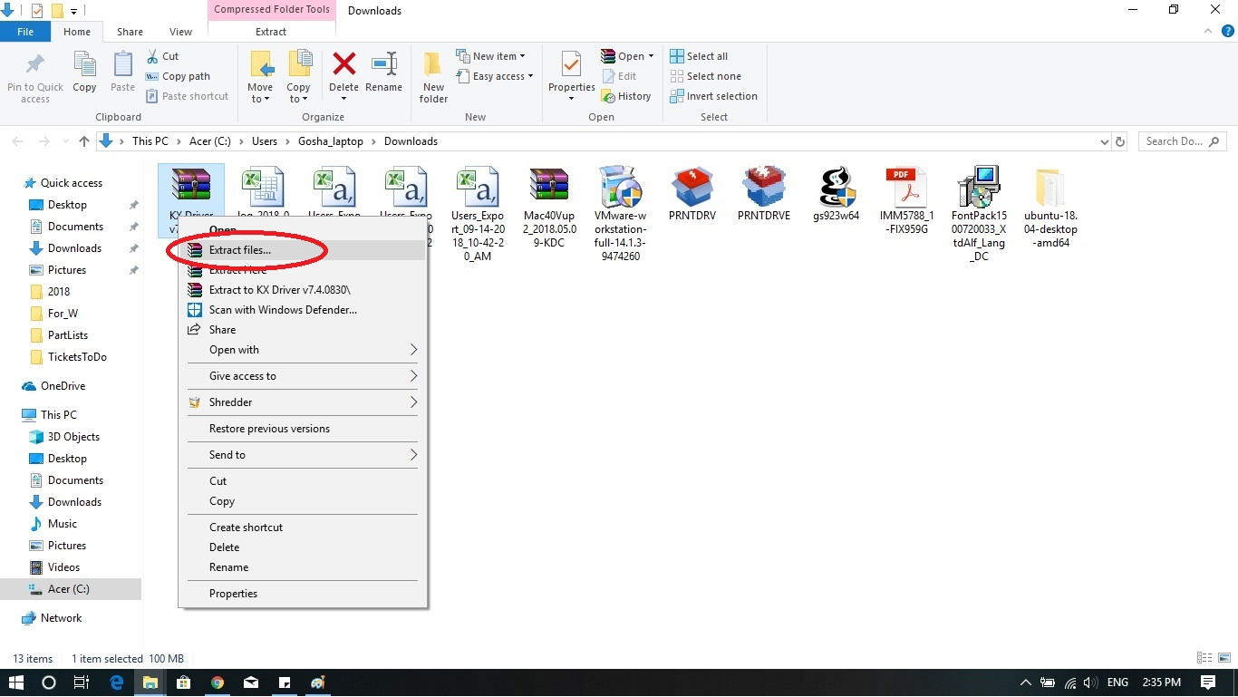
Once you right click on the downloaded file, you will see the pull down menu. Please, choose “Extract files…”.

Slide 16
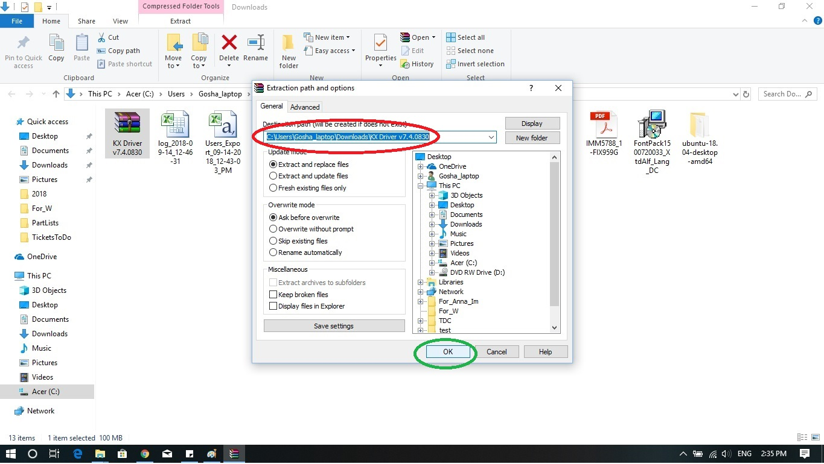
Choose the folder or keep the default folder and press “OK” at the bottom of the menu.

Slide 17
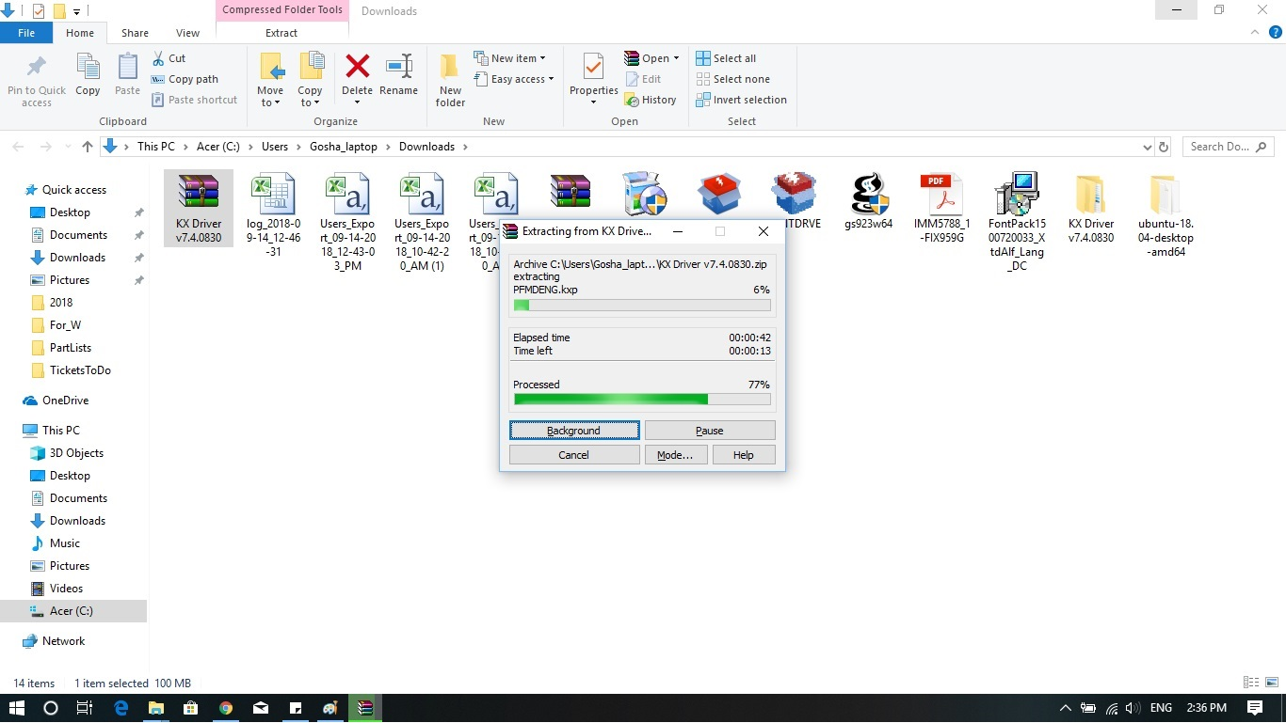
The system starts to extract the files to the previously specified folder.

Slide 18
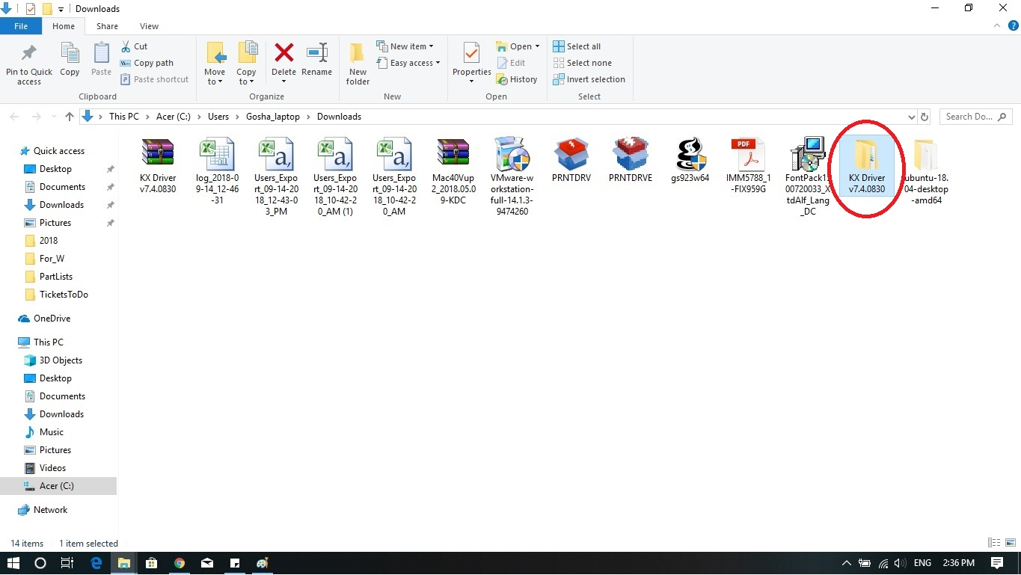
Once the extraction is over, you should see a new folder with the same name as downloaded file.

Slide 19
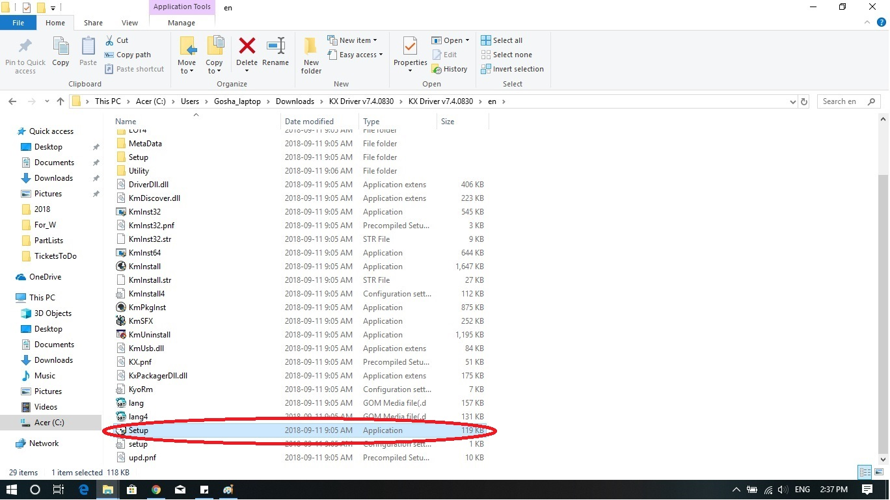
Open the folder and find the “setup” file. Open it. (double click on the file)

Slide 20
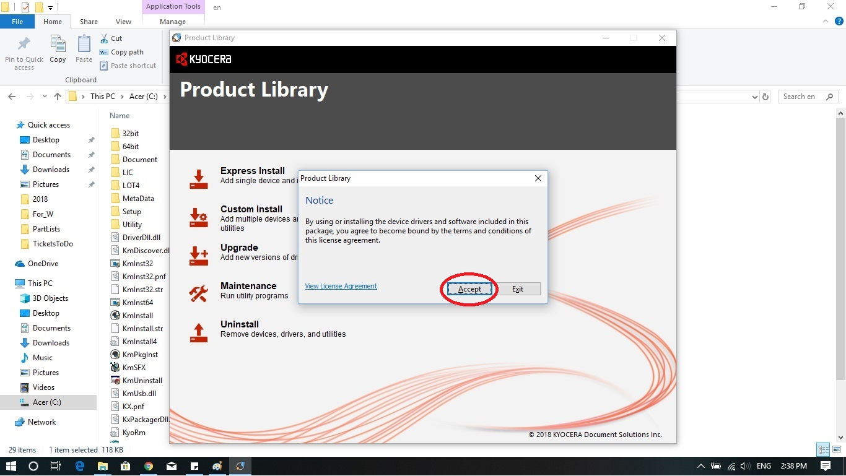
It takes several seconds to launch the installation application. You should see the “Notice” window on the screen. Press “Accept”.

Slide 21
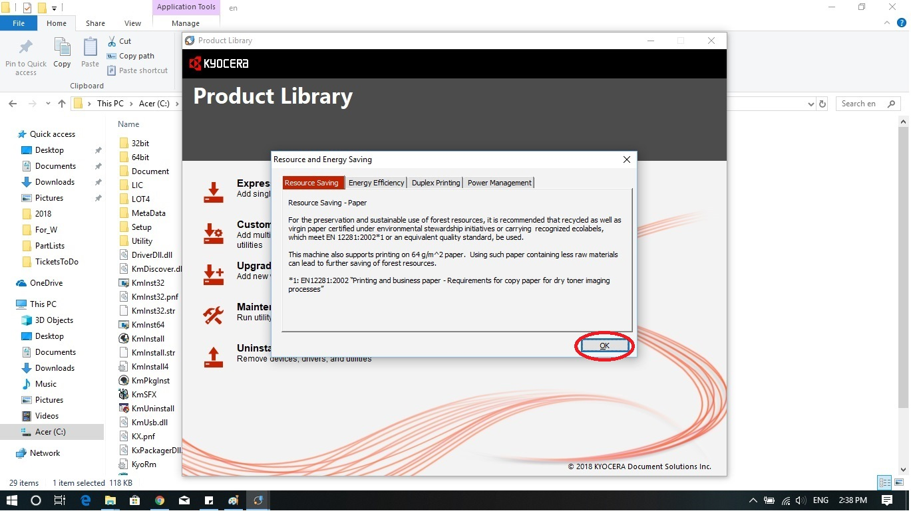
Press “OK”

Slide 22
Choose “Custom Install” option.

Slide 23
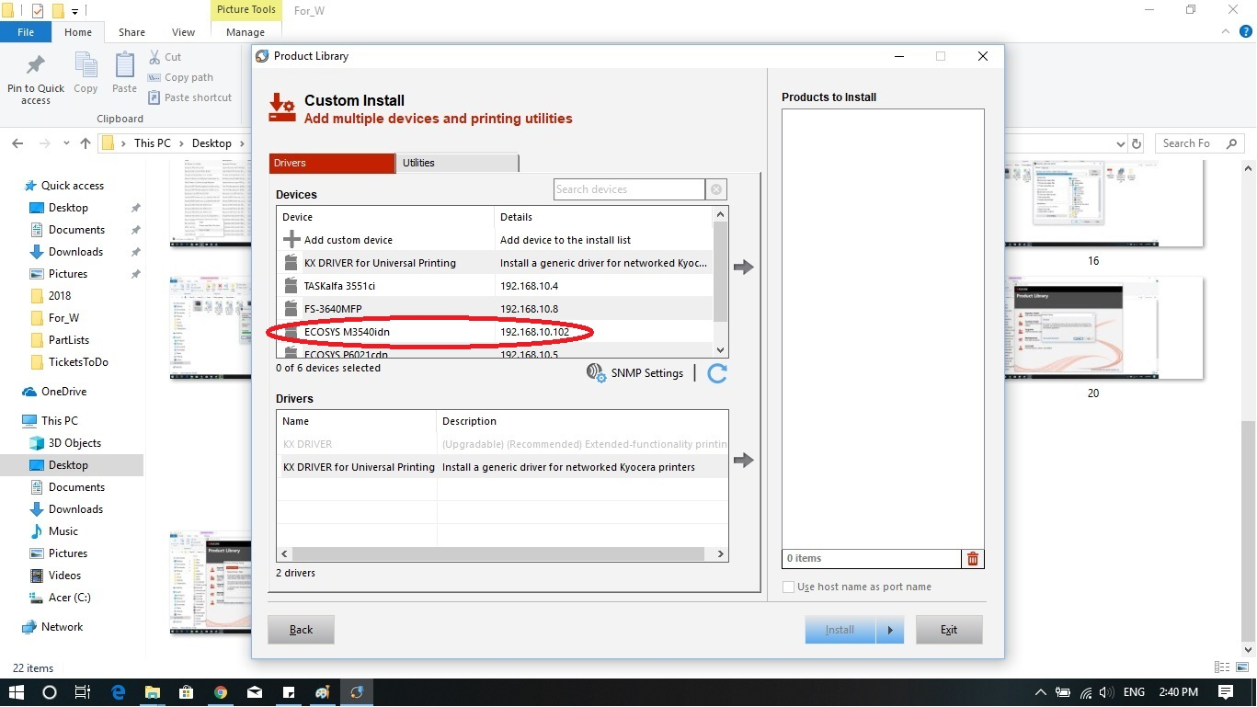
The application shows you the available devices in the first (top) sub window. Choose Ecosys M3550idn with IP address (the example is circled for you). Double click on the device. The device will be added to the right sub window.

Slide 24
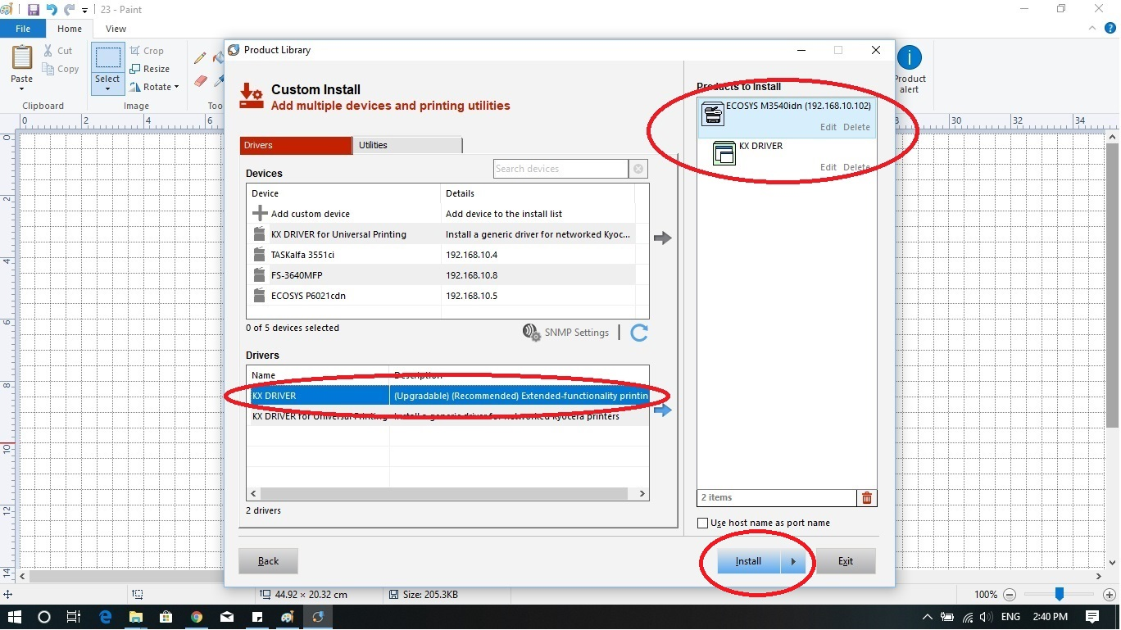
On the second sub window, double click on KX Driver Upgraded Recommended – the first on in the list. And press “Install”. Notice: make sure that you see the device name and the driver name on the right sub window like it is shown on the slide.

Slide 25
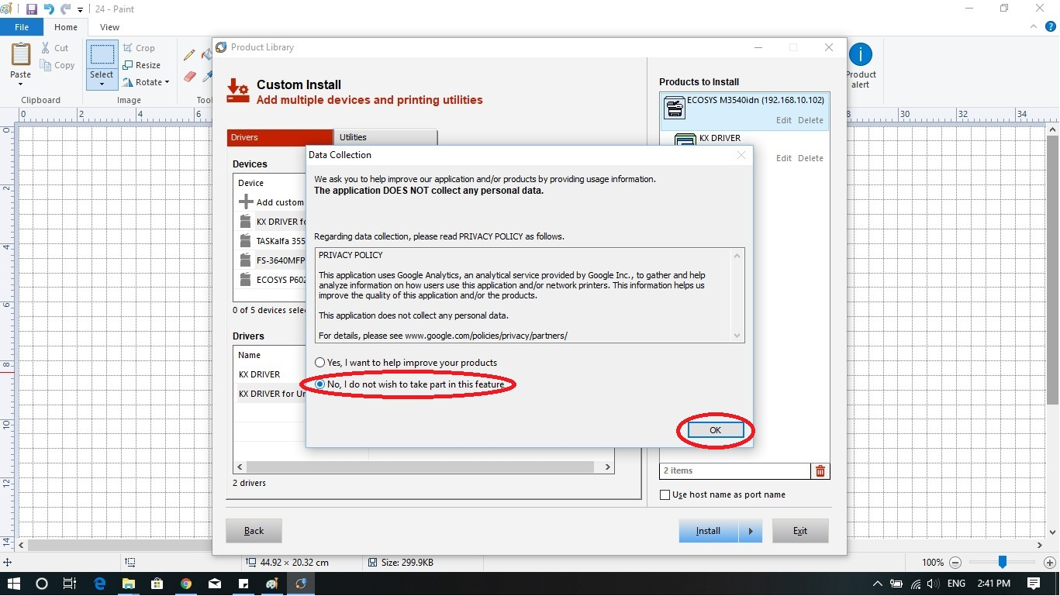
On this screen, just click on “No, I do not want to take…” and press on “OK” button.

Slide 26
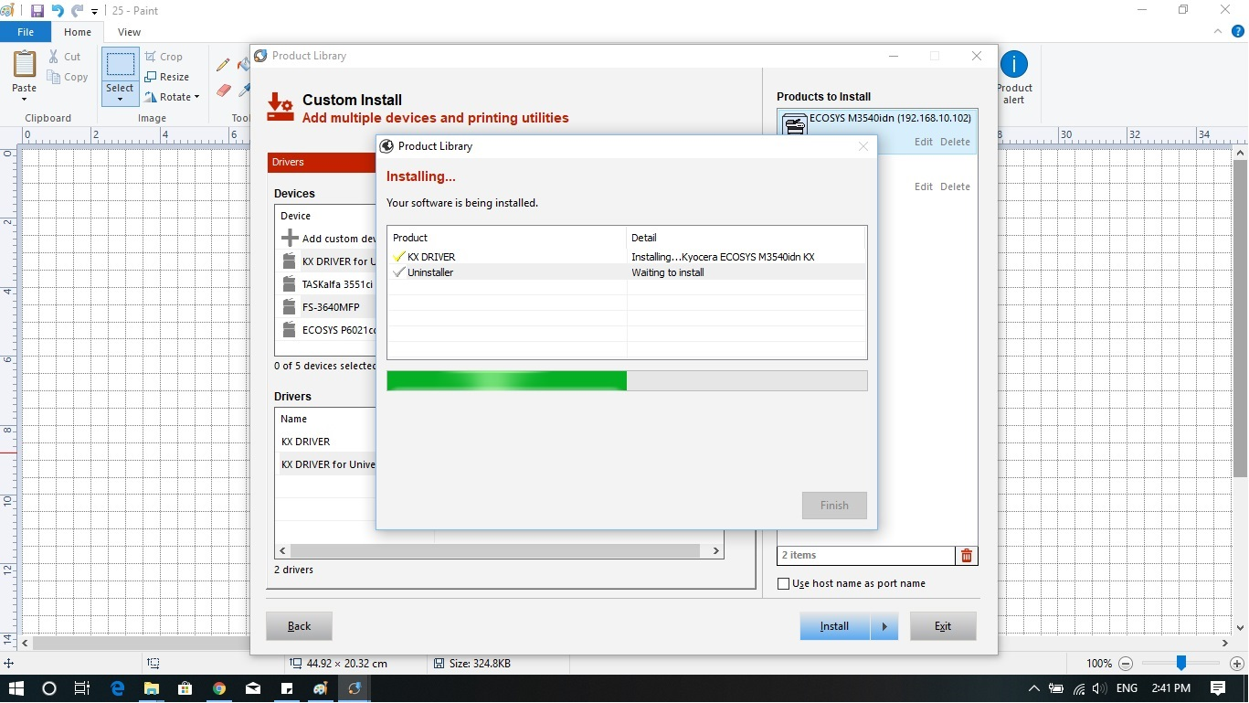
The installation process starts, and it takes a couple minutes to finish. So wait until the computer finishes the installation.

Slide 27
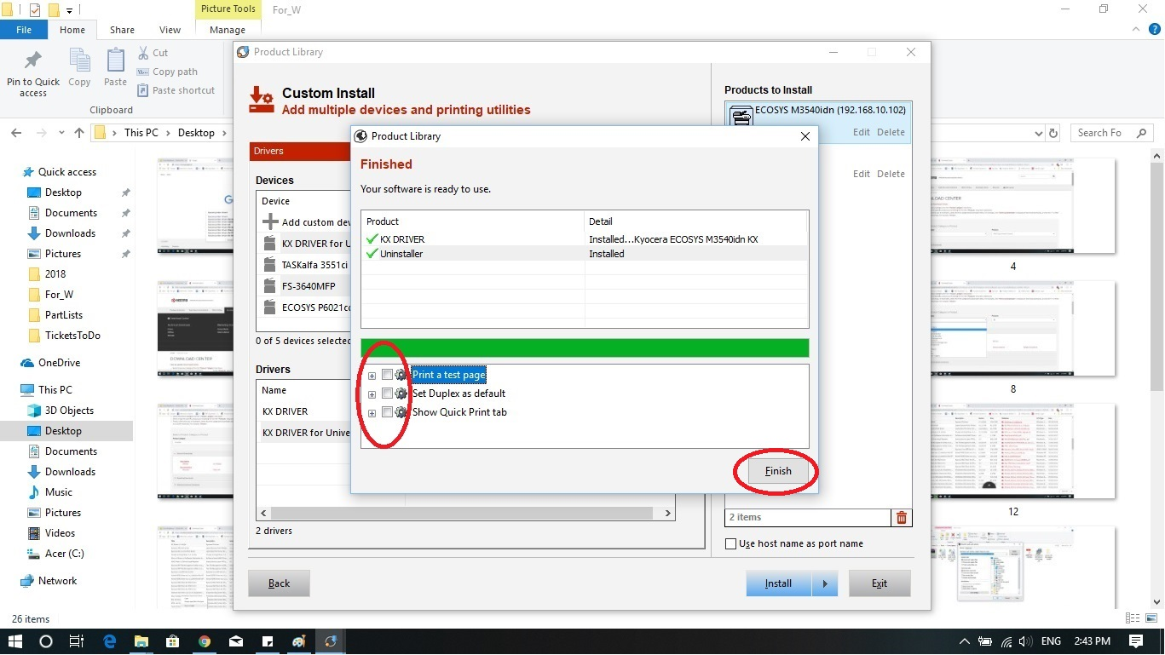
The installation is almost over. Unbox all the options and press “Finish”.

Slide 28
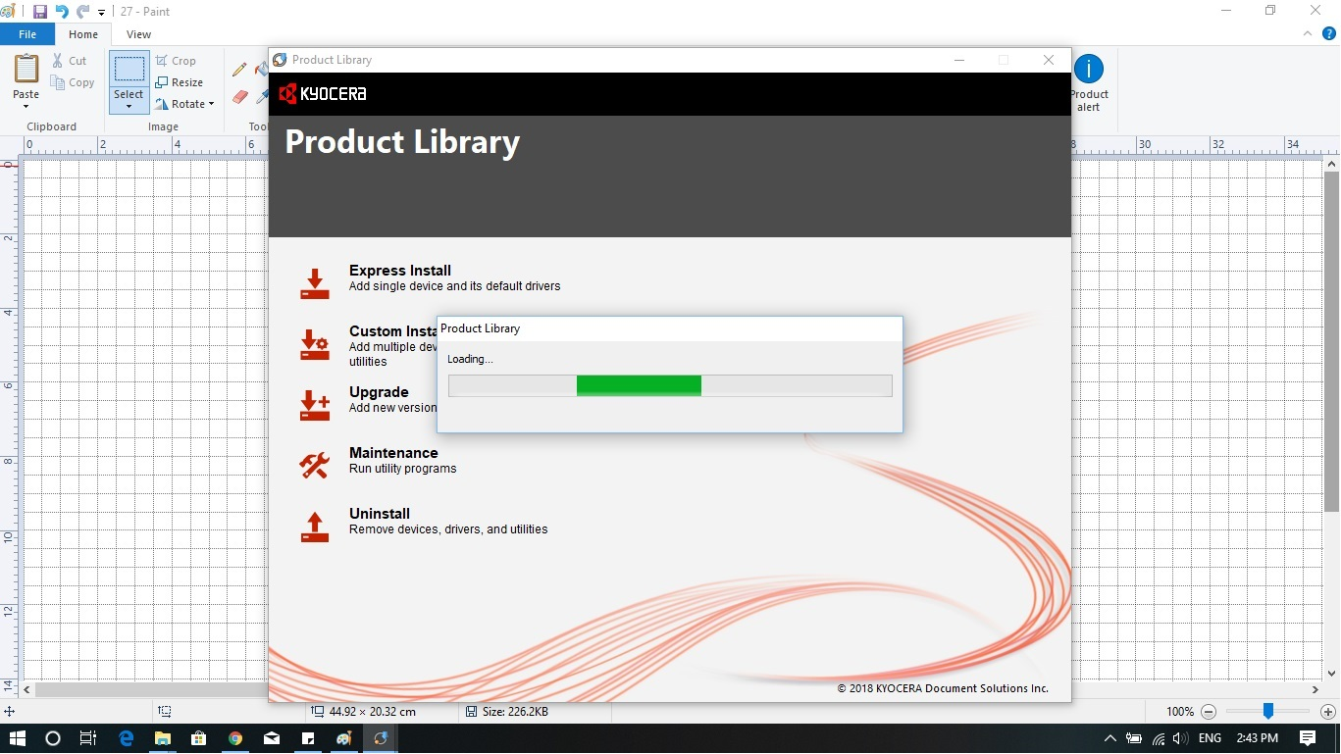
The application saving settings now.

Slide 29
You see the main screen of the installer program again. Please, press on “Maintenance”.

Slide 30
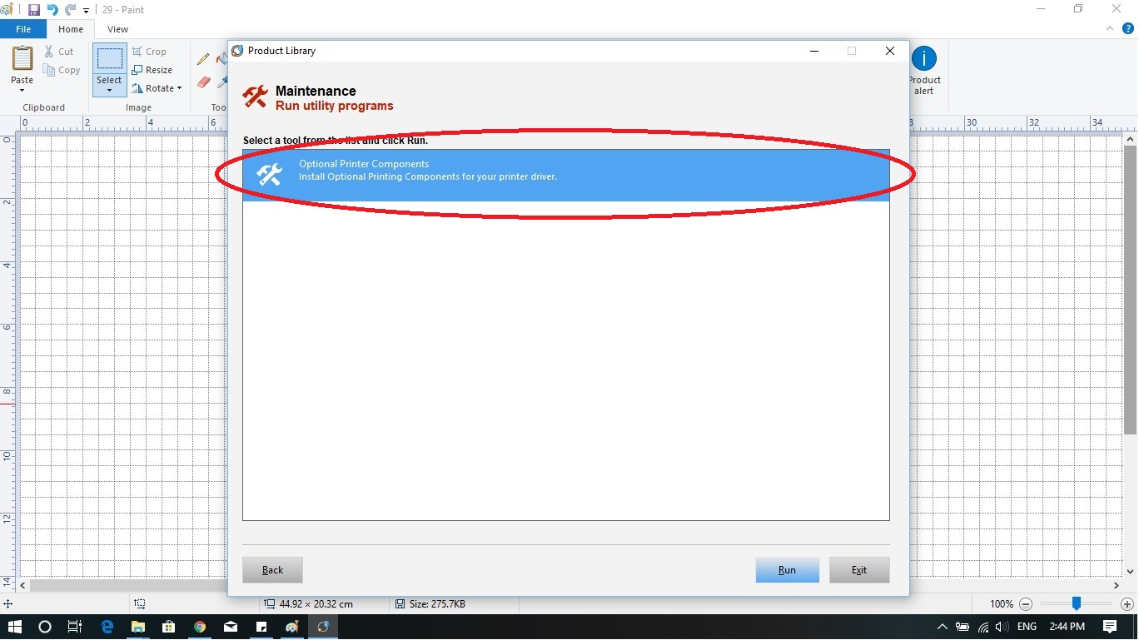
Choose the only one available option for you and press “Run”.

Slide 31
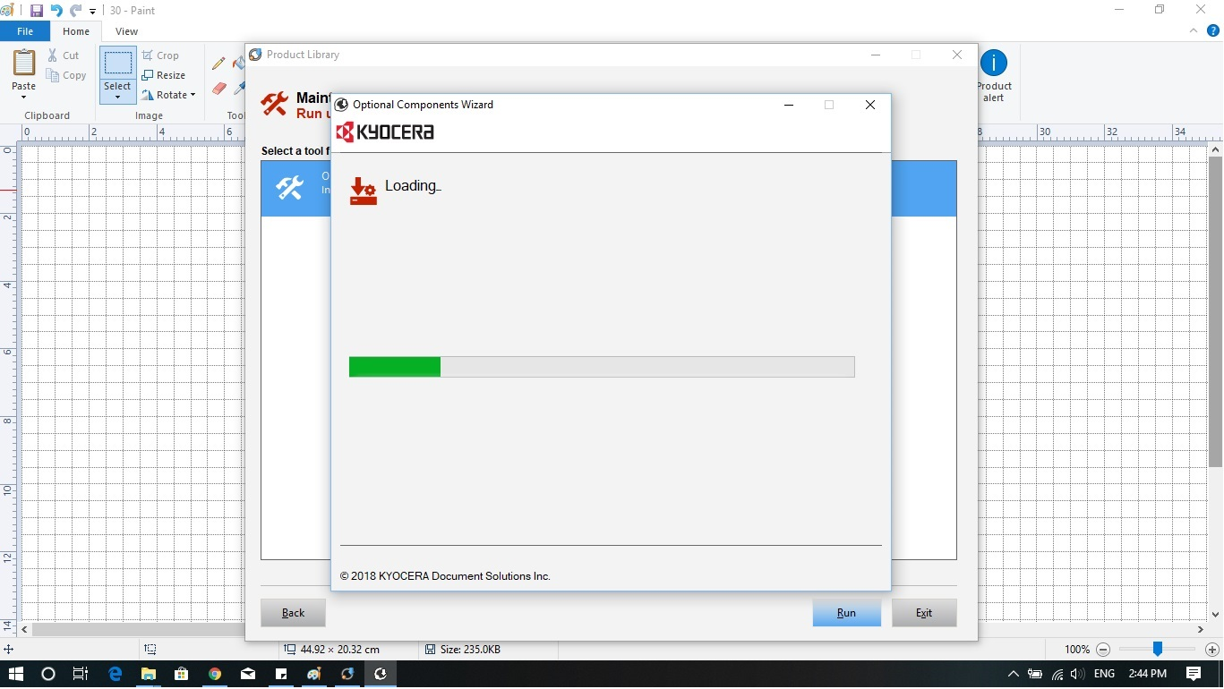
The application is loading the addition information. Wait until it is over.

Slide 32
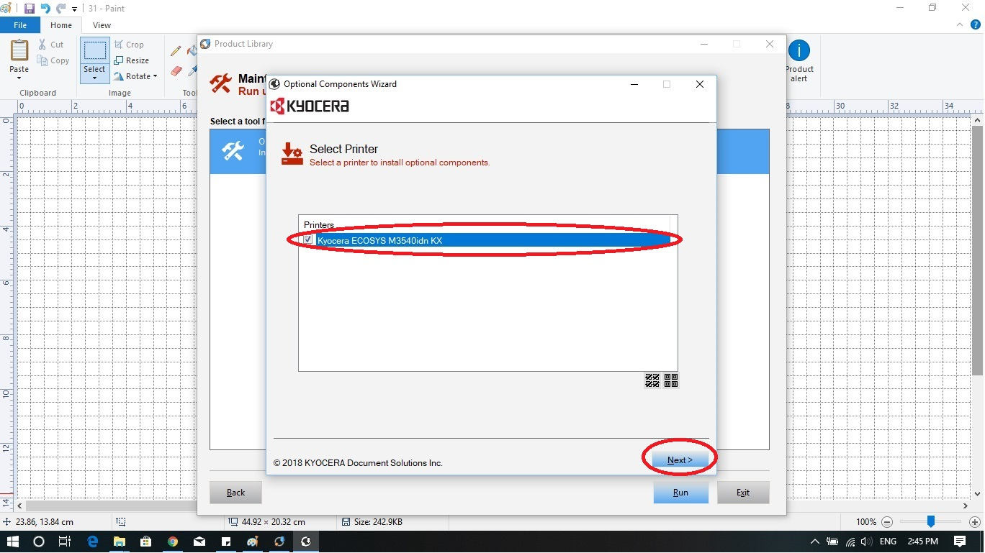
Once the application finished loading the addition info, you should see this screen. So, choose Kyocera Ecosys M3550idn and press “Next”.

Slide 33
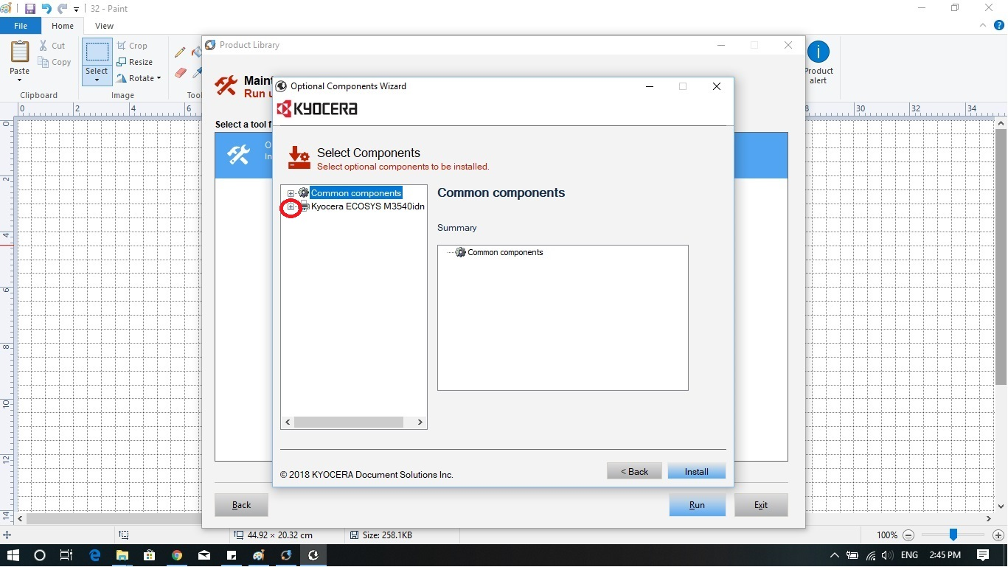
Extend “Kyocera Ecosys M3550idn” by pressing on “+”.

Slide 34
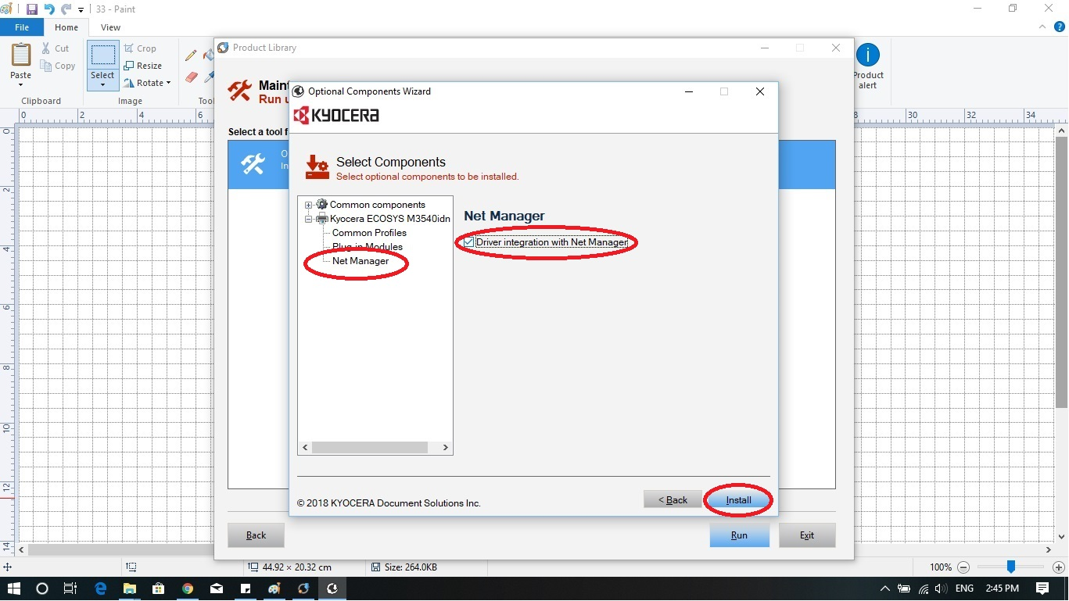
Click on “Net Manager” and choose Driver integration… (put a check mark in the box). Press “Install”

Slide 35
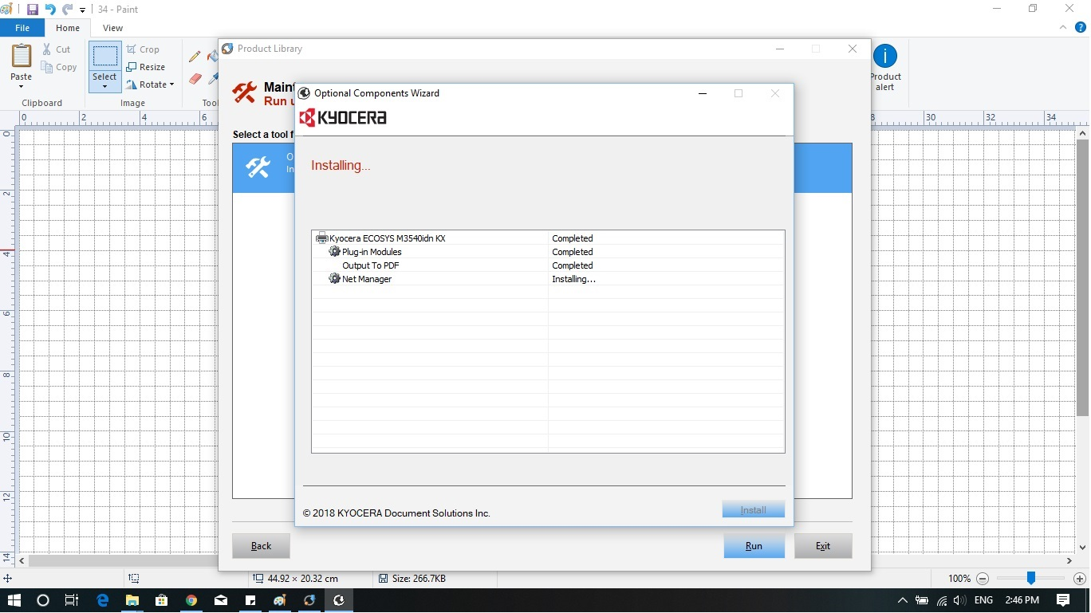
Installation process starts immediately. And it takes seconds to finish.

Slide 36
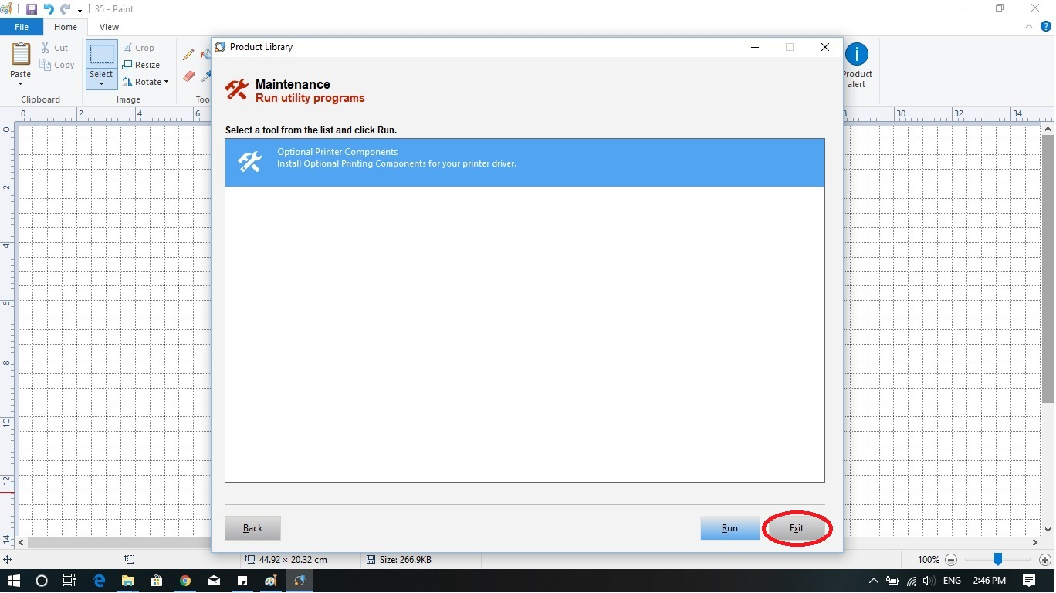
Once the installation is finished. Press “Exit”.

Slide 37
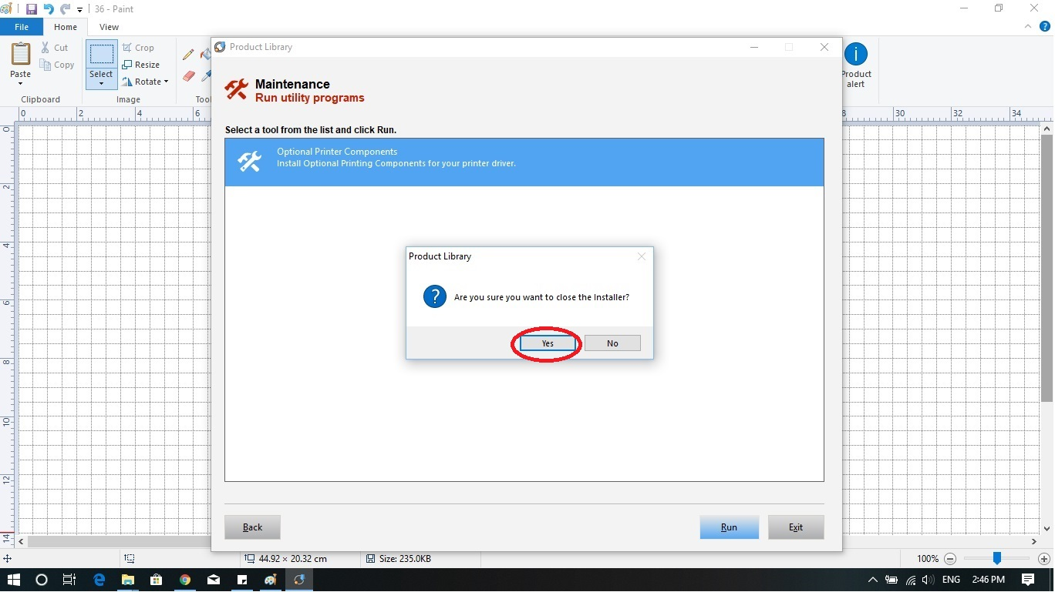
Press “Yes”.

Slide 38
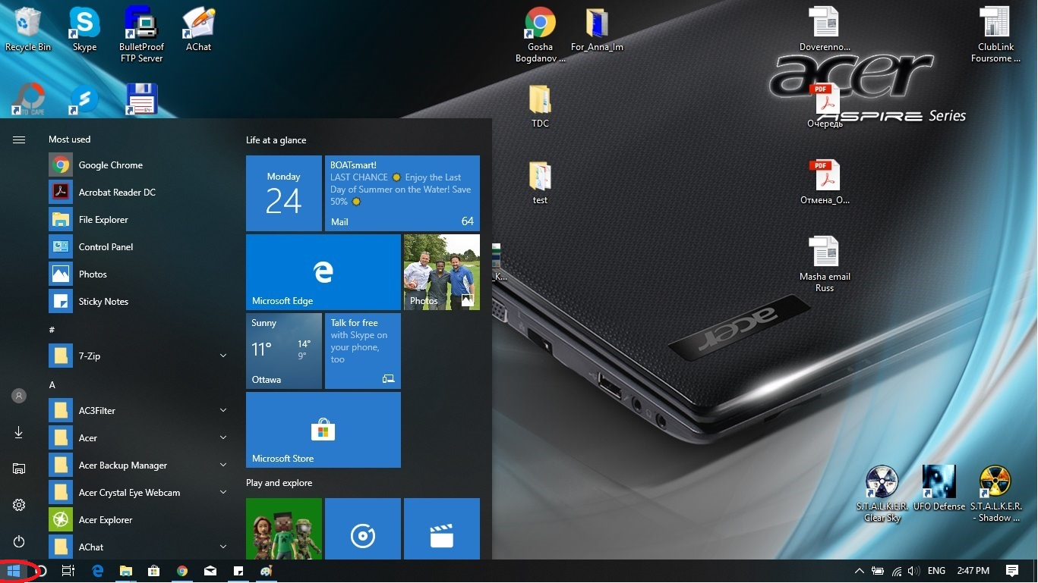
The installation application is closed now. We are about to configure the driver. Press on “Start” button.

Slide 39
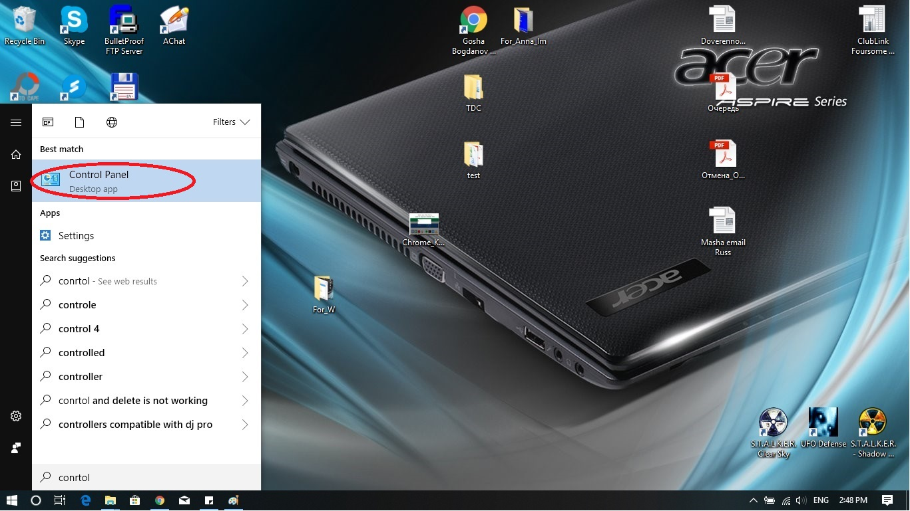
Type or find “Control Panel”.

Slide 40
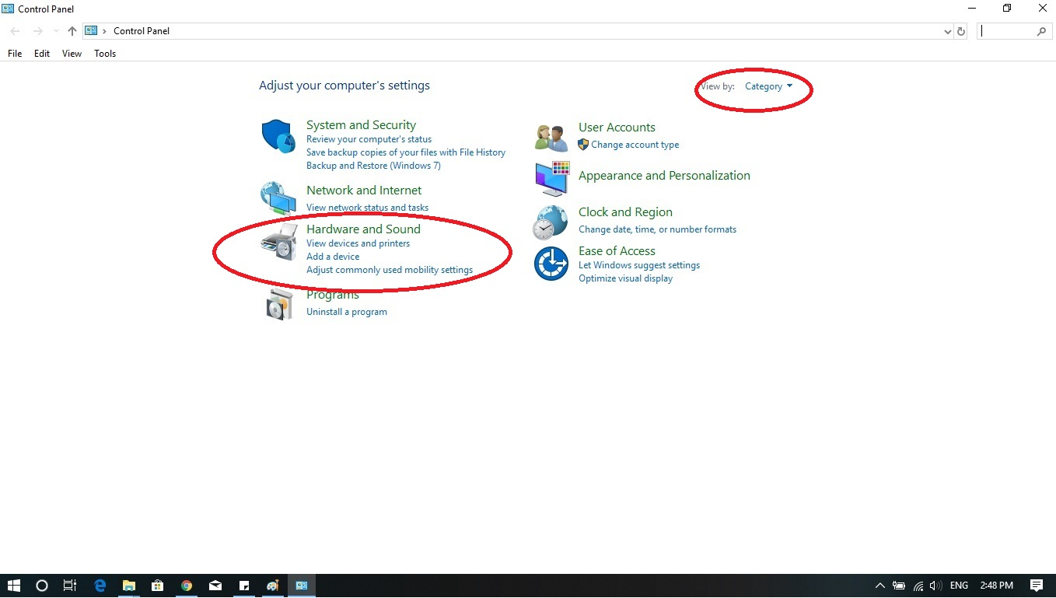
Choose “Hardware and Sound”. If you do not see the same screen, you may change the view by “Category”

Slide 41
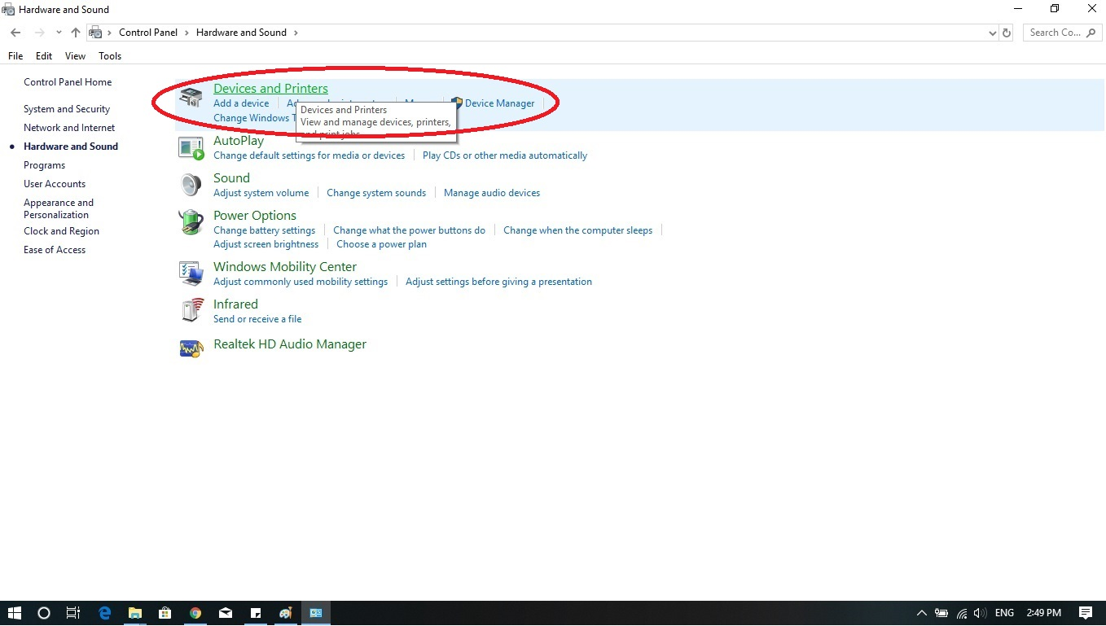
Click on Devices and Printers.

Slide 42
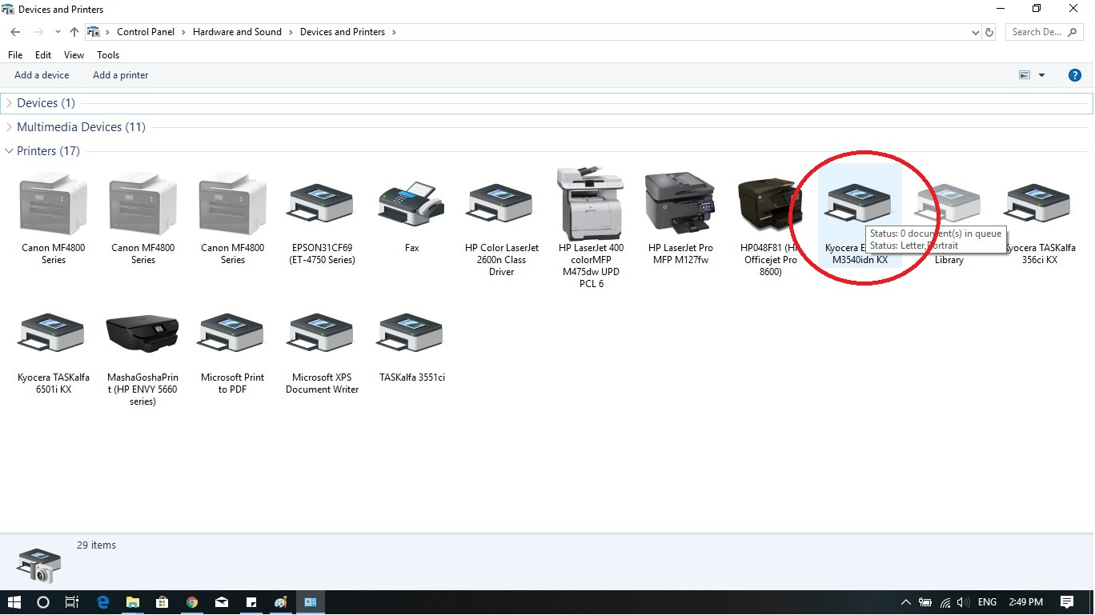
Find the printer that we just installed. Notice: usually Windows 10 sets a new printer as a default printer (green check mark on the icon of the printer)

Slide 43
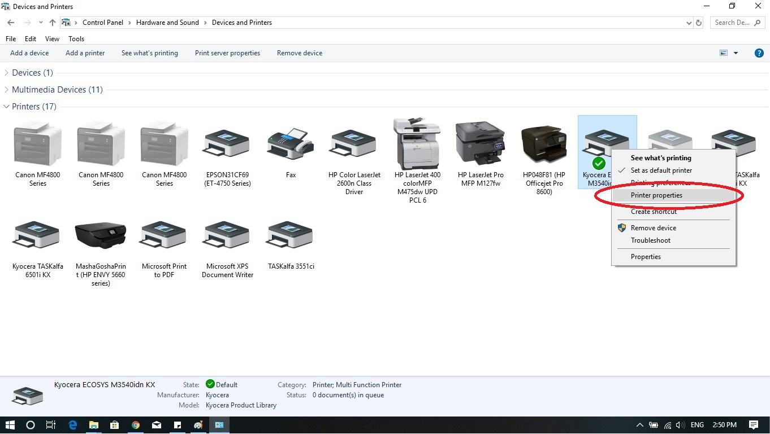
Right click on the icon of the printer and choose “Printer properties”.

Slide 44
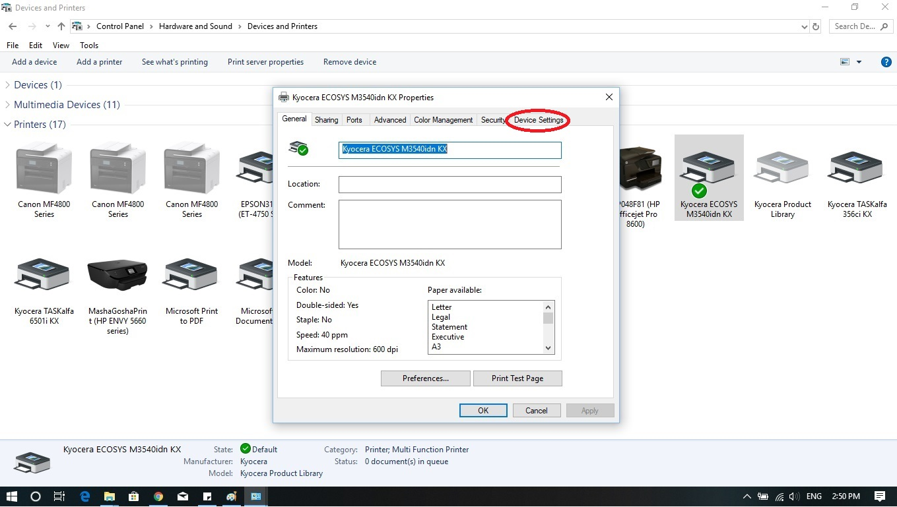
On the printer properties menu, click on “Device Settings” folder.

Slide 45
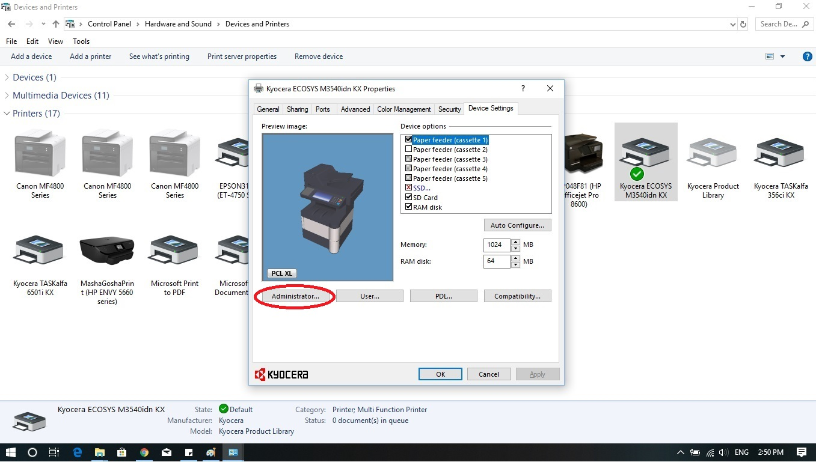
Click on “Administrator…” button.

Slide 46
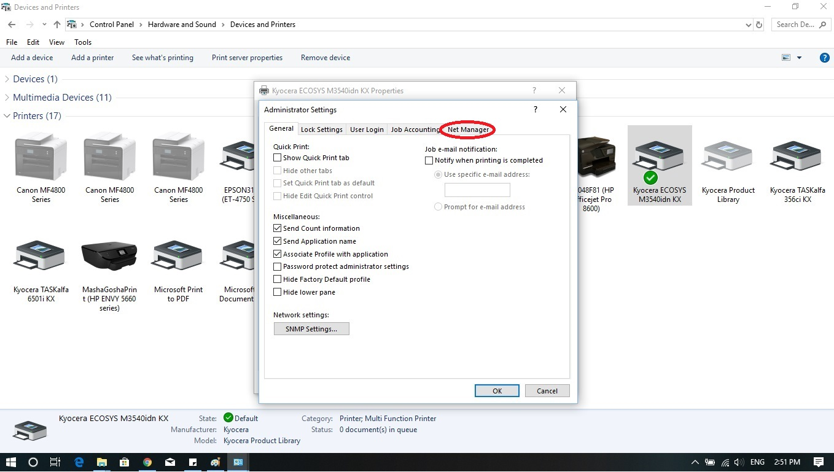
Click on “Net Manager” folder.

Slide 47
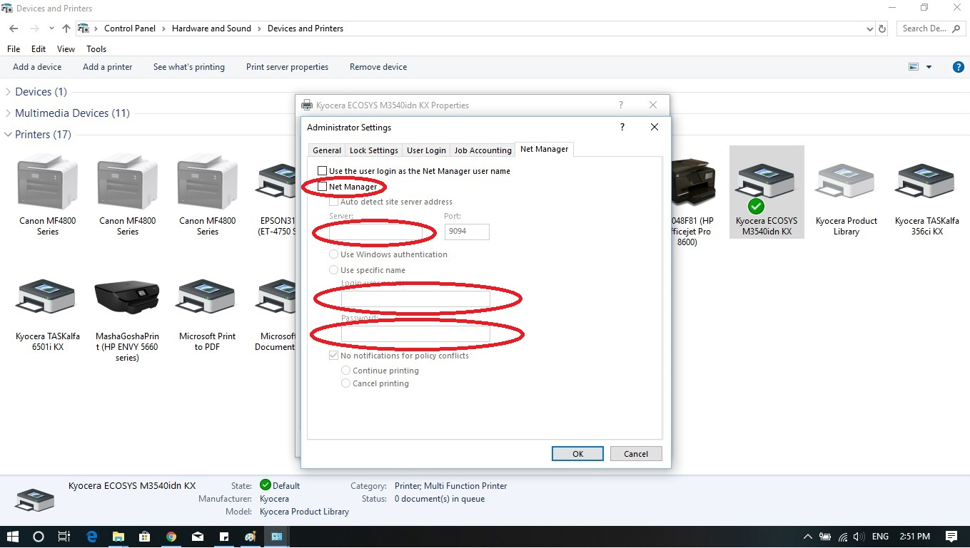
You see the settings for the Net Manager now. Please, configure this page according to the provided information from your Tech group and the school management, and some info you will see on the next slide.

Slide 48
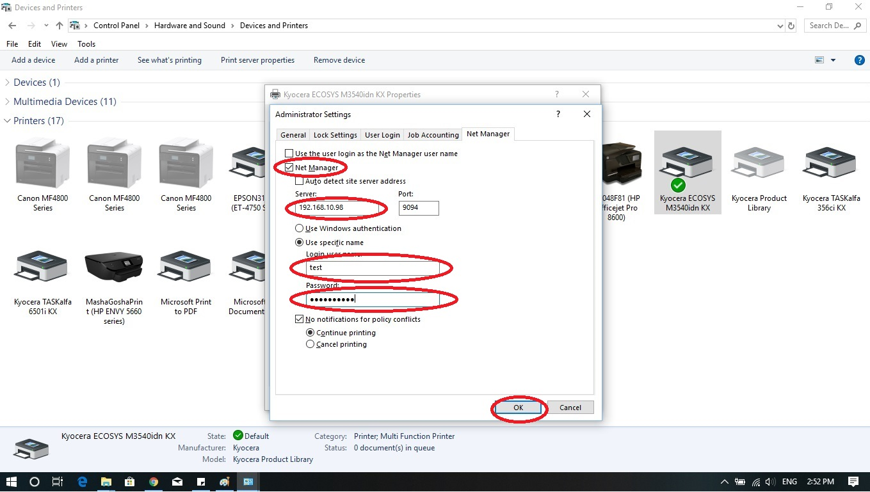
Your screen should look like this. Check mark for “Net Manager”, “Server” - provided by the Tech group, “Port” – 9094 (for everyone), check mark for “Use specific name”, “Login User Name” – provided by your school management or the Tech group, “Password” – 1087 (for everyone). Press “OK”. Notice: your screen should have all these lines filled or the printer will not work!!!.

Slide 49
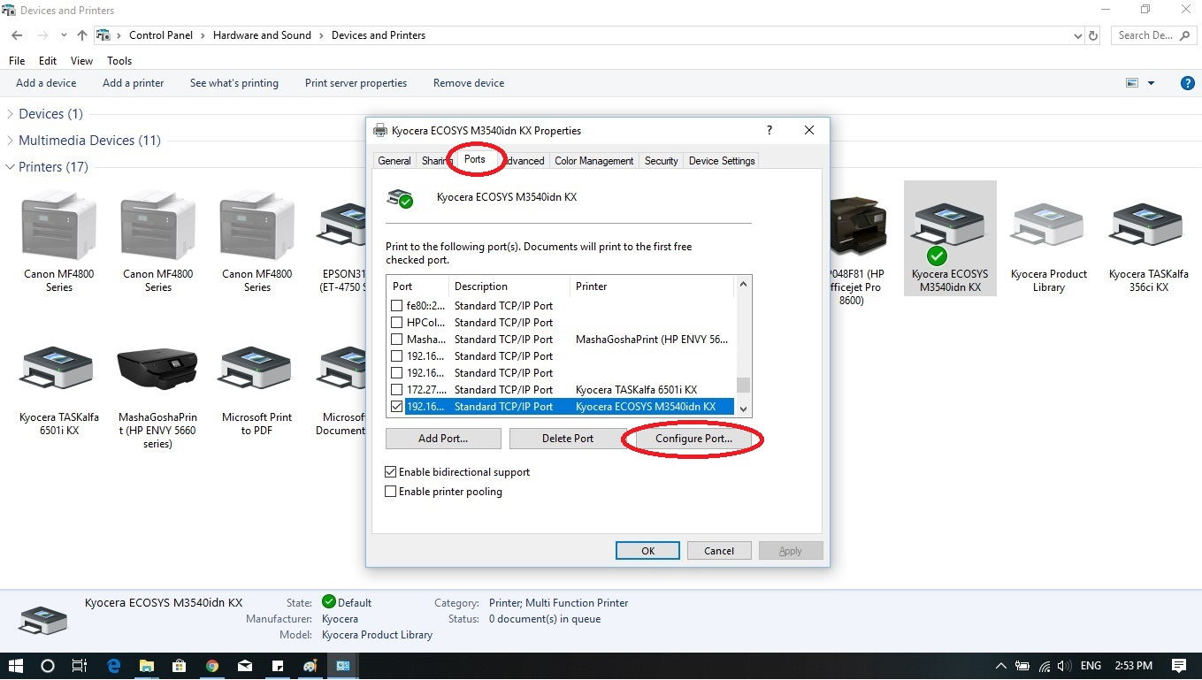
Now, click on “Port” folder and “Configure Port…” button. So your screen should look like this.

Slide 50
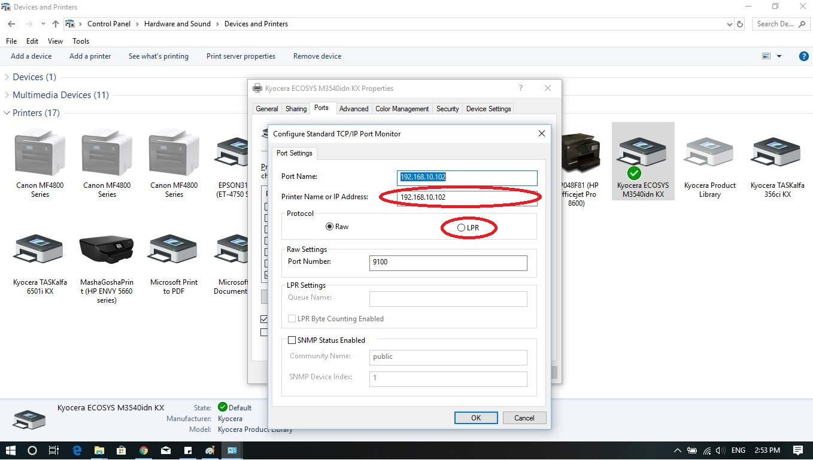
You are in the “Configure Standard TCP/IP Port Monitor”. Change the “Printer Name or IP address” to the same that you used on the slide #48 “Server” line (Example: 192.168.10.102) the tech group issued it for you. Press LPR button.

Slide 51
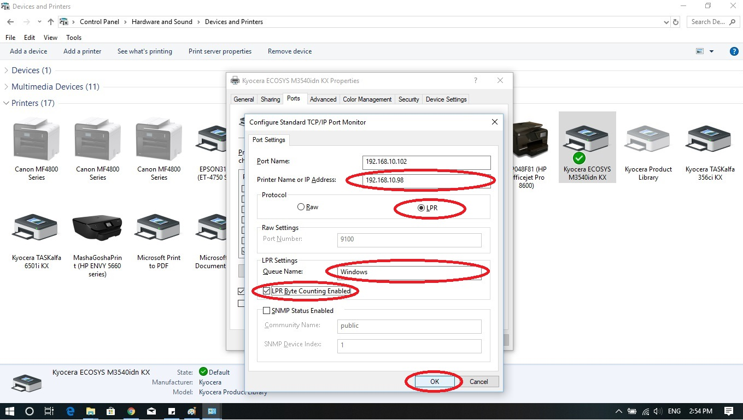
Your screen should look like this now. The second line changed, “LPR” has chosen, “LPR Byte Counting Enabled” has marked. “Queue name” is Windows . Press “OK”. Notice: queue name is case sensitive, IP address has to be the same as on the step #48 “Server” line (Tech support issued it for you).

Slide 52
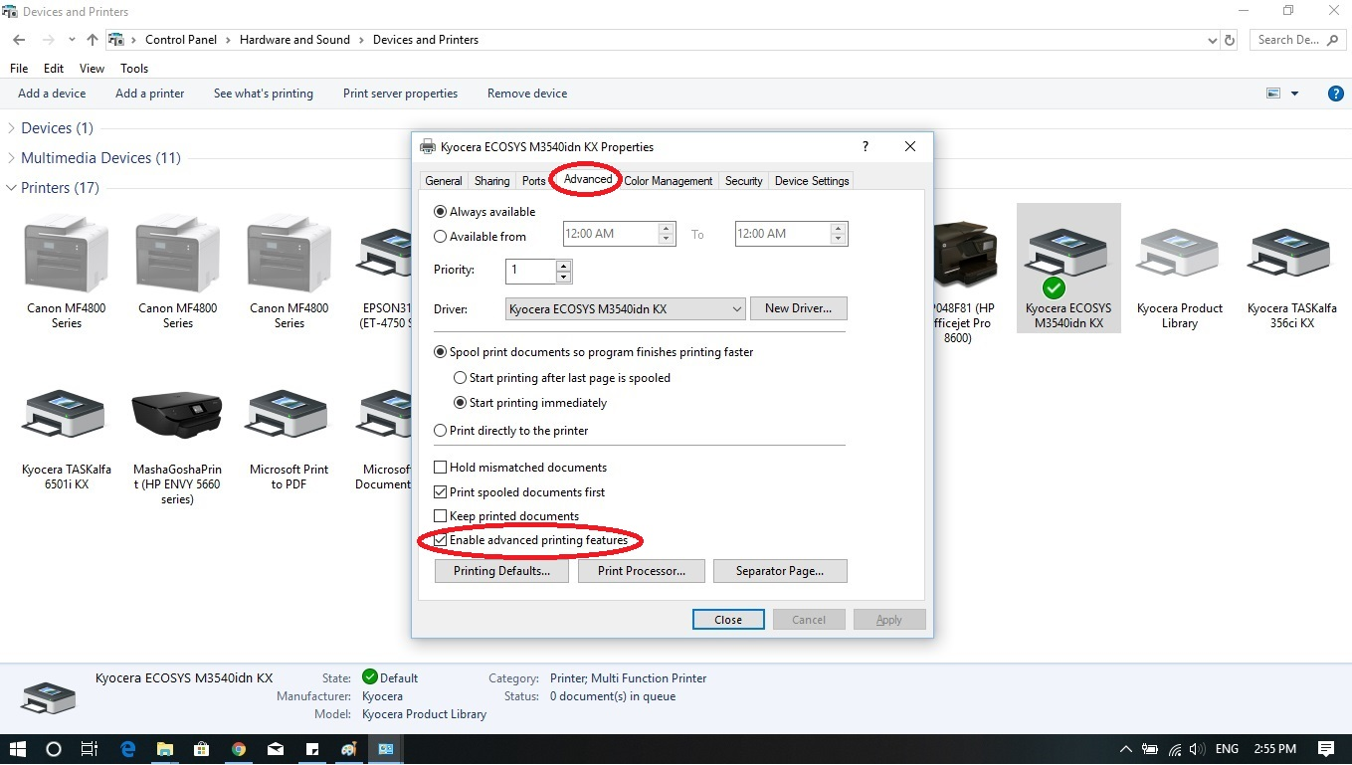
Now, press on “Advanced” folder. Unbox the “Enable advanced printing features”.

Slide 53
Your screen should look like this, with the unboxed advanced printing features. Press “Apply”. Press “General” folder.

Slide 54
Once you pressed “General” folder, you should see this screen. Now we are changing the name for the printer. Lets call it “School M3550idn KX”. Press “Apply”, press “Close”.

Slide 55
Open any document on your computer. Print it to the “School M3550idn KX” printer. Come to the actual printer and punch you ID. Press “OK” or the green arrow. Notice: your ID is different from the Password (1087) that you punched in the “Net Manager” sub folder during driver configuration. Obtain your ID from the school management or the Tech group.

Slide 56
Once you logged into the printer, you should see this screen with your name in the upper left corner and “Print All” with “1”. If you see it, means the setup was done properly. The configuration of your printer finished, and you are able to print your documents.

